Slide 1
Past, present and future of hard X-ray/γ-ray measurements of GRB polarization
P. Laurent
CEA/DSM/IRFU/SAP & APC
June, 13th 2012

Slide 2
Compton polarimetry principles
Compton scattering cross section is maximum for photons scattered at right angle to the direction of the incident electric vector ⇒ asymmetry in the azimuthal profile S of scattered events.
modulation
  a = modulation factor
  polar. fraction = PF = a/a₁₀₀
  a₁₀₀ = modulation for a 100 % polarized source.
  polar. angle = PA = ϕ₀ - π/2 + nπ
Incident photon
e
Scattered photon
June, 13th 2012
GRB polarisation observations

Slide 3
History of GRB polarization observations
The past : RHESSI
The present : Integral and GAP
The future : POLAR, NuStar, Astro-H, …
June, 13th 2012
GRB polarisation observations

Slide 4
GRB RHESSI observations
The RHESSI spectrometer.
Observation of polarization in GRB 021206.
Controversy on this measure.
June, 13th 2012
GRB polarisation observations

Slide 5
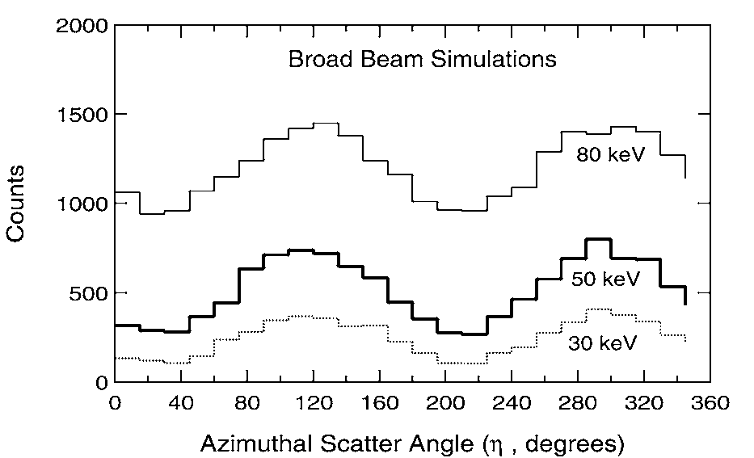
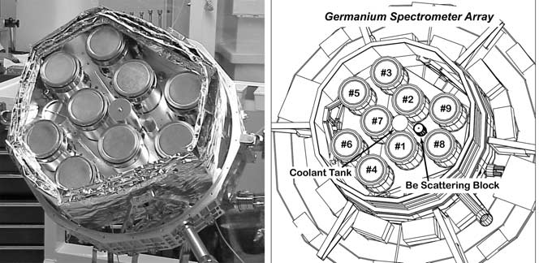
The RHESSI spectrometer
Launched in 2002 to study solar activity.
9 germanium detector with modulated coded mask.
Could measure polarization between 20 and 2 MeV.
a₁₀₀ ~ 40 % at 50 keV.
Mc Connell et al.,
2002, Solar Phys. 210, 125
June, 13th 2012
GRB polarisation observations

Slide 6
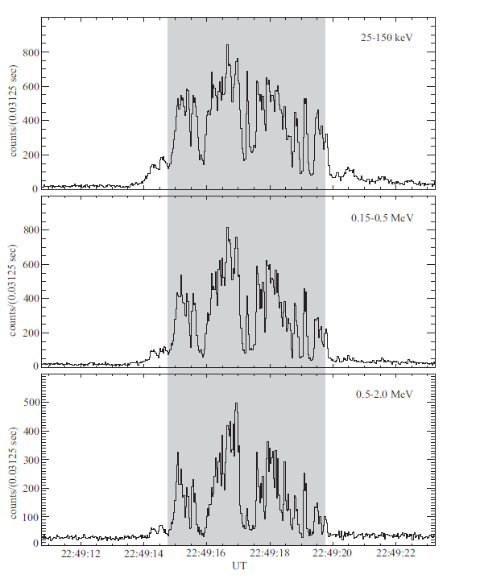
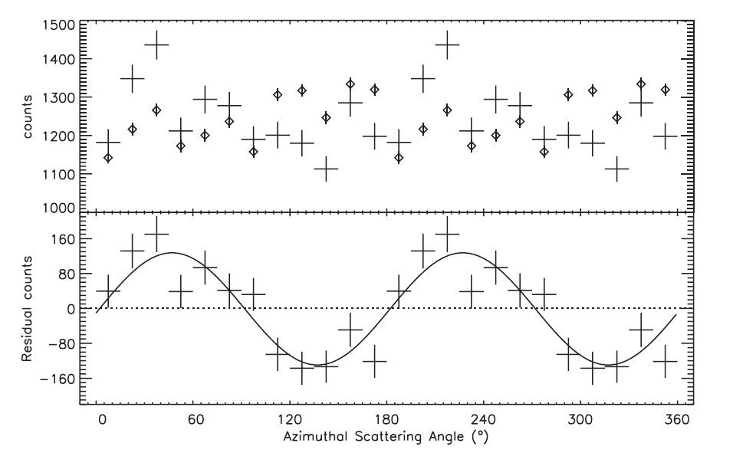
RHESSI observation of GRB021206
GRB 021206 : a bright GRB detected up to 2 MeV.
Data analysis : unpolarized signal simulated by Monte-Carlo and subtracted to real data.
Coburn & Boggs,
Nature, 2003, 423, 415
25 – 150 keV
150 – 500 keV
500 keV – 2 MeV
150 keV – 2 MeV
June, 13th 2012
GRB polarisation observations

Slide 7
Controversy
Data reanalyzed in 2004 by Rutledge & Fox (MNRAS 350, 1288 (2004) :
    Real double events number is a factor 10 below than this estimated by Coburn & Boggs ⇒ lower S/N.
    Polarization signal is in fact dominated by systematics.
⇒ Difficulty of polarization data analysis
June, 13th 2012
GRB polarisation observations

Slide 8
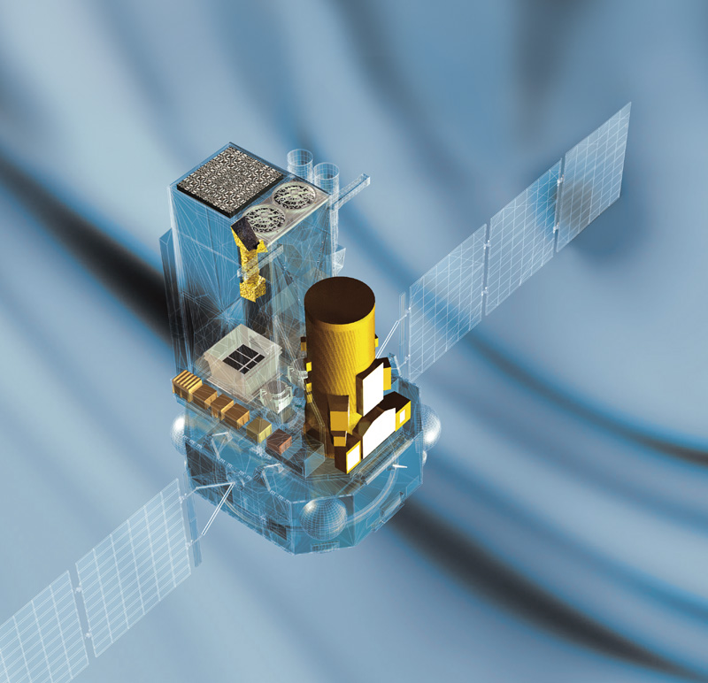

Satellite
4.1 tons
5 m height
3.7 m diameter
Launched in 2002
INTEGRAL Scientific payload
OMC (optical)
ISDC
IBIS
15 keV – 10 MeV
12’ FWHM imaging
<1’ source location
19°x19° FOV
JEM-X
SPI
20 keV – 8 MeV
2 keV FWHM
26° Ø FOV

Slide 9
Integral GRB observations
Polarimetry with the Integral IBIS/Compton telescope.
Polarimetry with the Integral/SPI telescope.
Observation of variable polarization in GRB 041219A.
Constraints on LIV from GRB 041219A observations.
June, 13th 2012
GRB polarisation observations

Slide 10

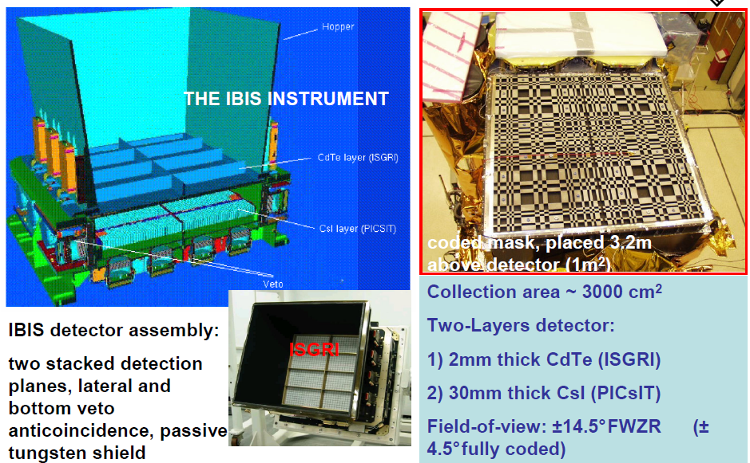
The IBIS telescope
June, 13th 2012
GRB polarisation observations

Slide 11
The IBIS/Compton telescope
The IBIS telescope is a coded mask telescope which could be used as a Compton telescope.
The Compton mode events are ISGRI and PICSIT events in temporal coincidence, within a window τ_{W} ≈ 3.8 μs.
Incident photon
ISGRI
e
PICsIT
Scattered photon
Within this window, chance coincidence, called hereafter “spurious events”, may also occur.
June, 13th 2012
GRB polarisation observations

Slide 12
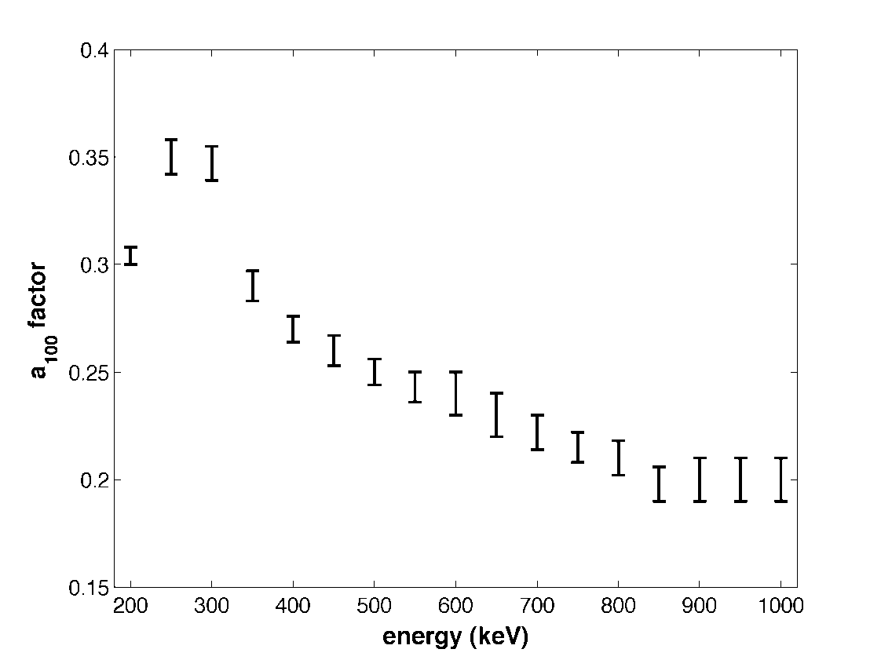
The a₁₀₀ factor
a₁₀₀ necessary to estimate the pulse fraction.
a₁₀₀ estimate: GEANT 3/ GLEPS simulation for a 100 % linearly polarized source.
a₁₀₀ = 0.304 ± 0.003 for a Crab-like spectrum
No on-ground calibration.
GEANT 3 simulation:
a₁₀₀ between 0.2 and 0.4
June, 13th 2012
GRB polarisation observations

Slide 13
Data analysis summary
Spurious events correction
Uniformity correction
Coded mask deconvolution
June, 13th 2012
GRB polarisation observations

Slide 14
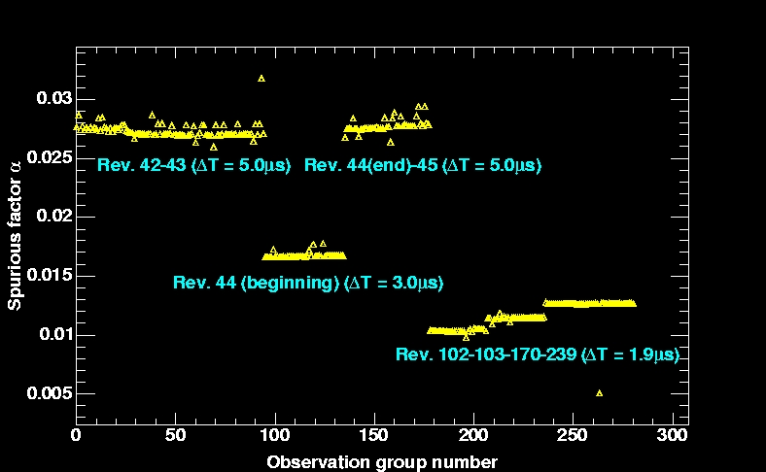
Spurious correction
“SPURIOUS EVENTS”
1 ISGRI event + 1 independent PICSIT event detected during the coincidence window
False source detection
1. We compute the spurious events contribution: N_{SPUR}/N_{ISGRI} ~ τ_{W}N_{PICSIT}
2. We compute “fake” spurious events, composed of one ISGRI single event randomly associated to one PiCsIT single event.
3. We build sky image with these events that we subtract from the Compton ones.
June, 13th 2012
GRB polarisation observations

Slide 15
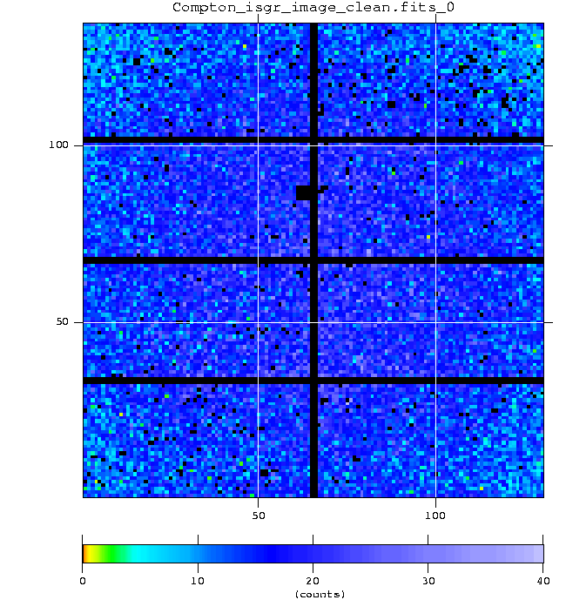
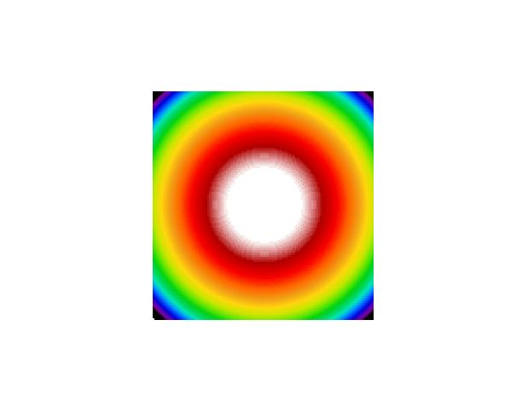
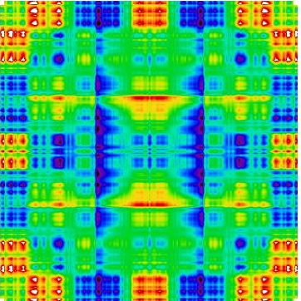
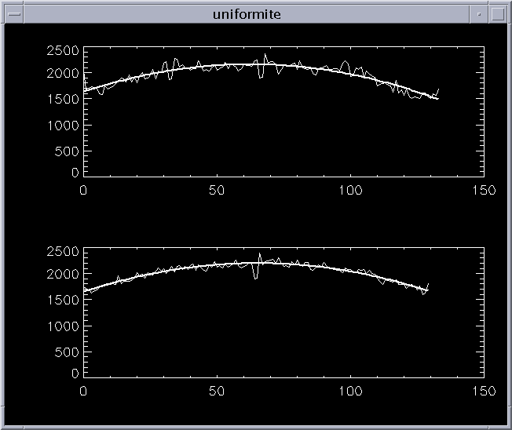
Compton imaging:
Non-uniformity corrections
Compton/ISGRI image
Uniformity map
Uniformity map deconvolved
Uniformity profiles
June, 13th 2012
GRB polarisation observations

Slide 16
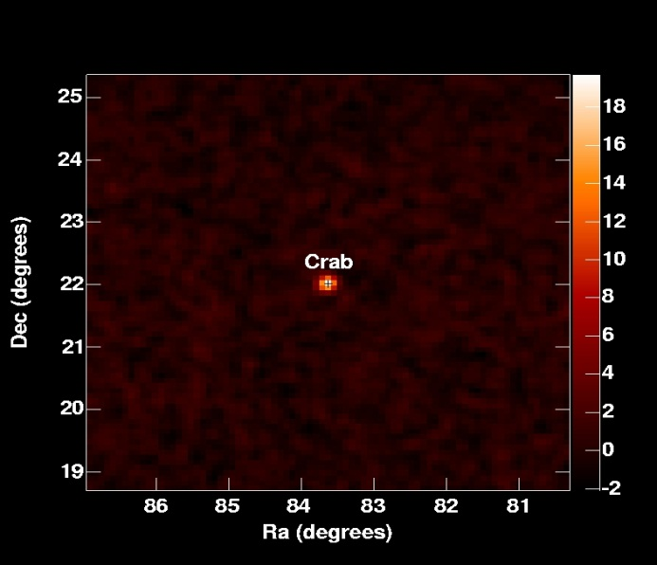
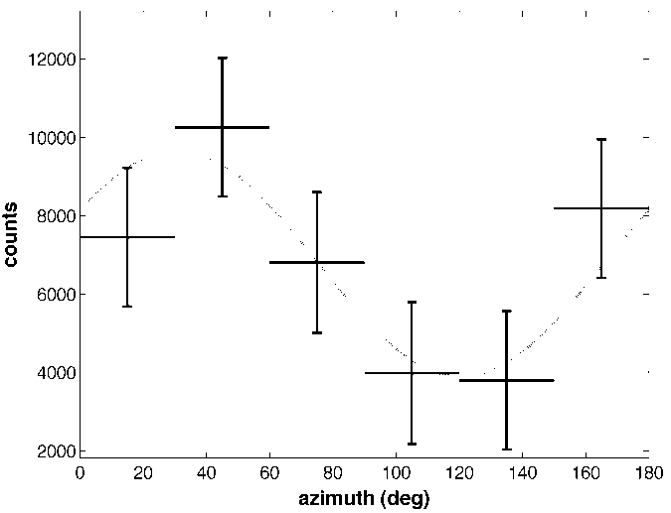
Image deconvolution
Shadowgram deconvolution
200-800 keV T=300 ks
shadow
⇒ SOURCE DIRECTION
June, 13th 2012
GRB polarisation observations

Slide 17
Checks for systematics
maximum modulation for unpolarized data?
(square detectors, grids, pixels, mask pattern…)
strong calibration source
  at 392, 511, 662 keV
  a < 5-7 %
empty fields
  a < 5 %
observations at ≠ source-detector angles
  same results
spurious event files
  a = 15 % @ 180°
Spurious events
June, 13th 2012
GRB polarisation observations

Slide 18
Polarimetry with the SPI telescope
June, 13th 2012
GRB polarisation observations

Slide 19
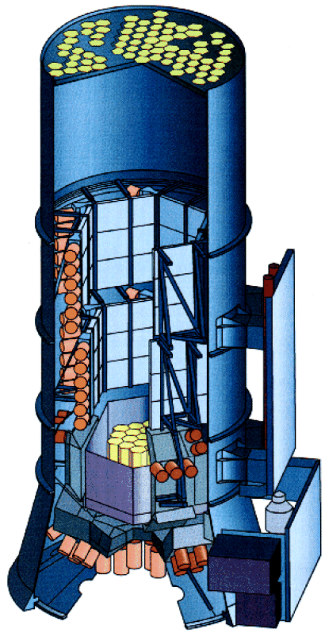
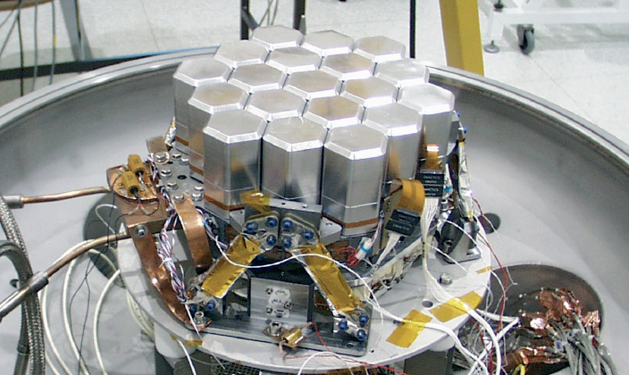
Polarimetry with SPI
SPI has also be used as a Compton telescope using multiple events in the Germanium detectors
ϕ - angle between incident photon polarisation direction and scattered photon direction.
φ
June, 13th 2012
GRB polarisation observations

Slide 20
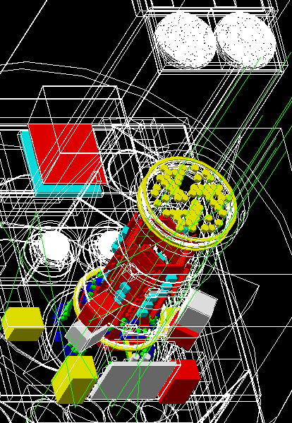
Polarimetry with SPI
Polarimetry with SPI is determined using a very detailled Mass Model (Dean 08)
Photons with the same spectrum and direction as the source under investigation are simulated interacting with a detailed model of SPI and the surrounding spacecraft.
The energy deposits can be analysed in the same manner as for the real instrument
The flux is modelled with different angles of polarisation
Then compared to the real data taken by the instrument.
June, 13th 2012
GRB polarisation observations
Notes:
20

Slide 21
Polarimetry with SPI
Mass Model simulation of Crab spectrum for each pointing
18 polarised beams for each azimuthal angle in 10º steps between 0º and 170º (180º symmetry) + 1 non-polarised
~700,000 singles & ~70,000 doubles produced for each pointing
Polarised & unpolarised simulated data combined to produce any percentage polarisation (Π) needed using:
P₁₀₀ = 100% polarised
P₀ = unpolarised
P% = percentage polarised data
June, 13th 2012
GRB polarisation observations

Slide 22
Polarimetry with SPI
Data fitted on a Science window by Science window basis
Each adjacent detector pairs considered (Pseudo detectors: 42 later reduced to 32 after failure of the two Ge pixels)
Recorded data from Crab modelled as:
S = the Crab strength
C = count distribution from the simulation
B_{i} = spatial distribution of the background
B_{s} = background variation in time
June, 13th 2012
GRB polarisation observations

Slide 23
Study of polarisation of GRB 041219A
June, 13th 2012
GRB polarisation observations

Slide 24
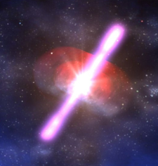
GRB 041219A in a few words
GRB 041219A was detected in december 2004 by the Integral Burst Alert System (IBAS).
Longest and brightest GRB detected in the Integral FOV so far …
The Integral Spectrometer (SPI) already reported a high polarisation level (68 %) observed during the brightest part of this GRB (Mc Glynn et al., 2007)
June, 13th 2012
GRB polarisation observations

Slide 25
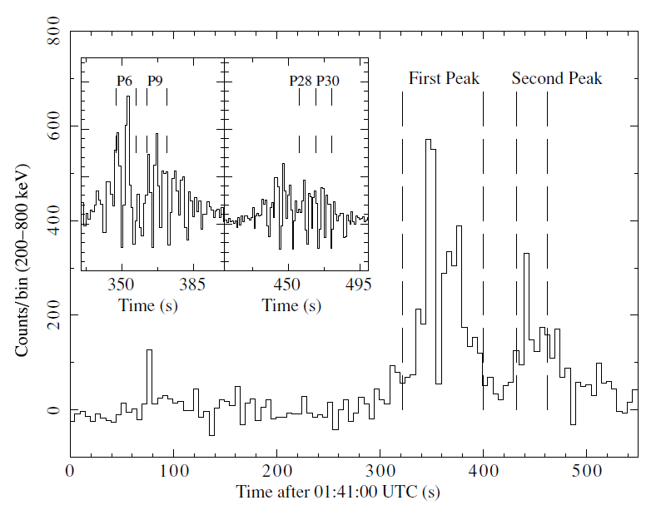
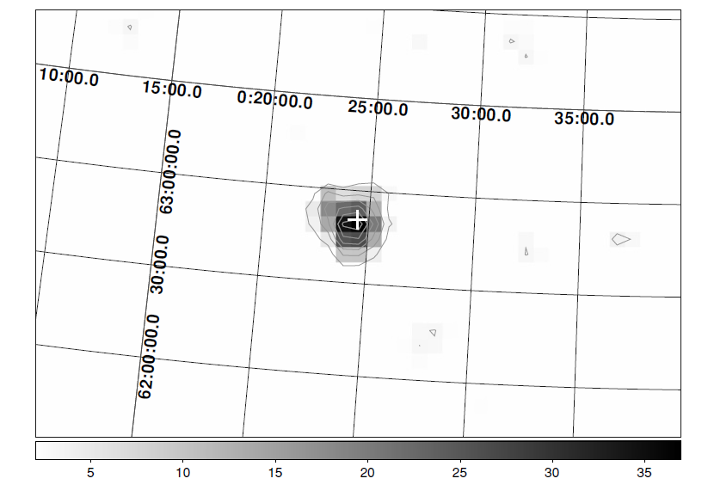
GRB 041219A Compton light curve
Analysis in 10s bins
Total S/N
(200-800 keV) 37 σ
5s bin
June, 13th 2012
GRB polarisation observations

Slide 26
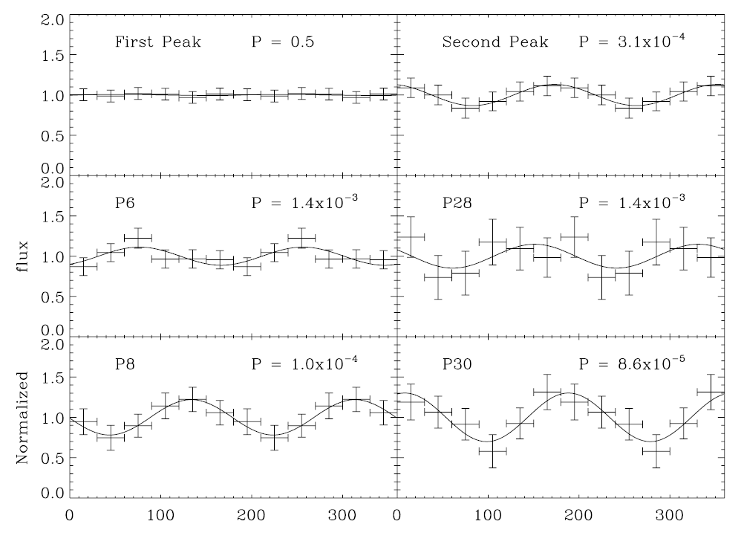
GRB 041219A polarisation diagrams
= SPI
June, 13th 2012
GRB polarisation observations

Slide 27
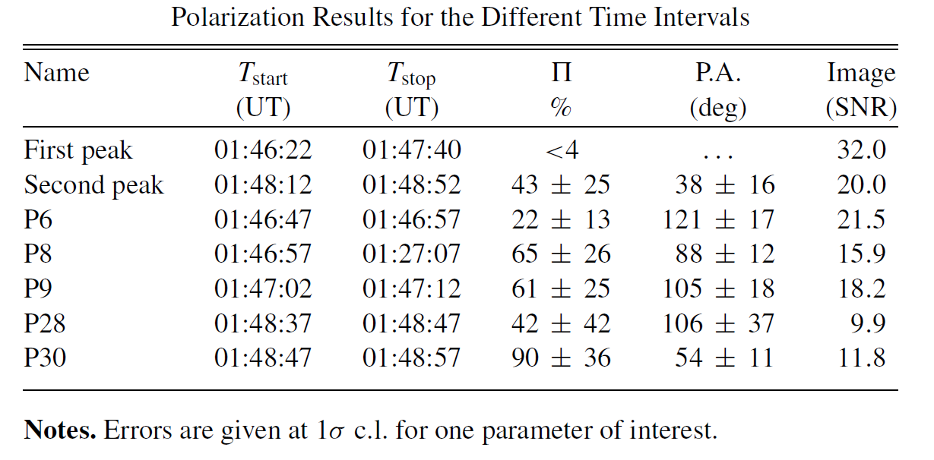
GRB 041219A polarisation results
= SPI
SPI : 63 ± 30 % P.A. = 70 ± 12°
June, 13th 2012
GRB polarisation observations

Slide 28
GRB 041219A: constraints on LIV
LIV : Lorentz invariance violation
LIV => rotation of the polarization angle
Already studied using the SPI measurement of Crab polarization (Maccione et al. 2008)
June, 13th 2012
GRB polarisation observations

Slide 29
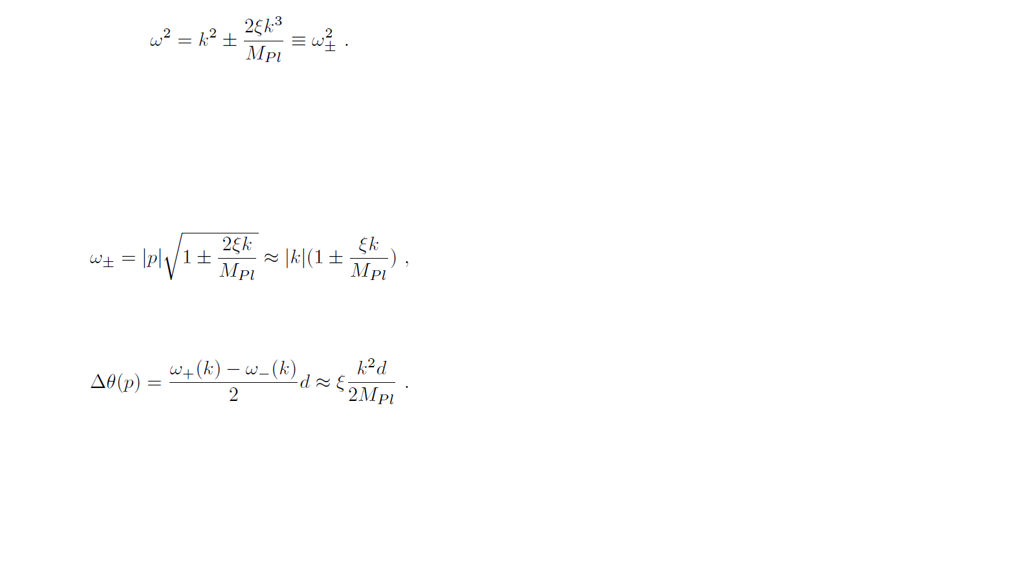
GRB 041219A: constraints on LIV
Principle:
Light dispersion relation:
M_{Pl}: reduced Planck scale (2.4 10¹⁸ GeV)
June, 13th 2012
GRB polarisation observations

Slide 30
GRB 041219A: constraints on LIV
Crab: ξ < 2 10⁻⁹ (Maccione et al. 2008)
GRB : at least 10⁵ times further away
June, 13th 2012
GRB polarisation observations

Slide 31
GRB 041219A: distance determination
Redshift measure with the CFHT/WirCAM instrument (Götz et al., 2011):
=> z = 0.31 ^{+0.54} _{-0.26}
=> d = [0.222-5.406] Gpc
with standard cosmological parameters
(Ω_{m}=0.3, Ω_{λ}=0.7, H=70 km/s/Mpc)
June, 13th 2012
GRB polarisation observations

Slide 32
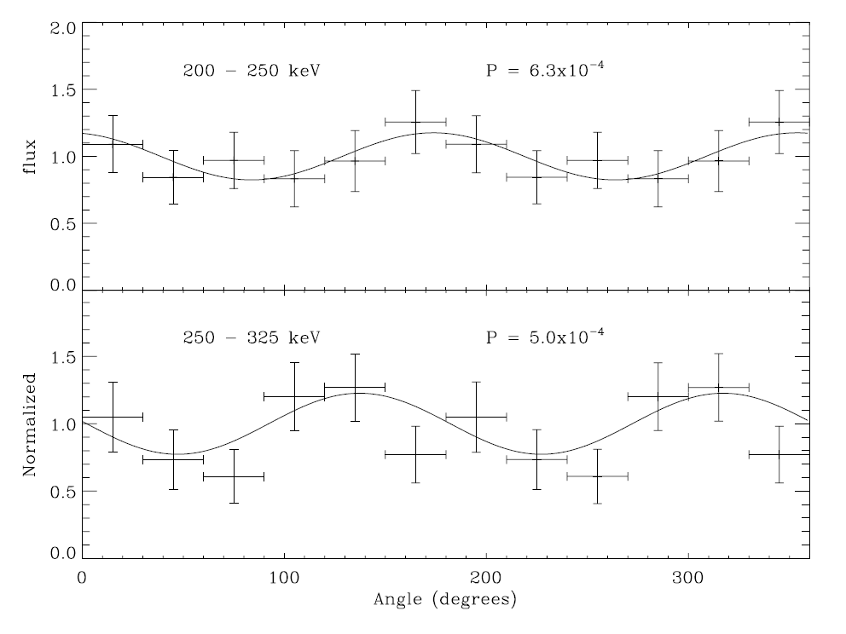
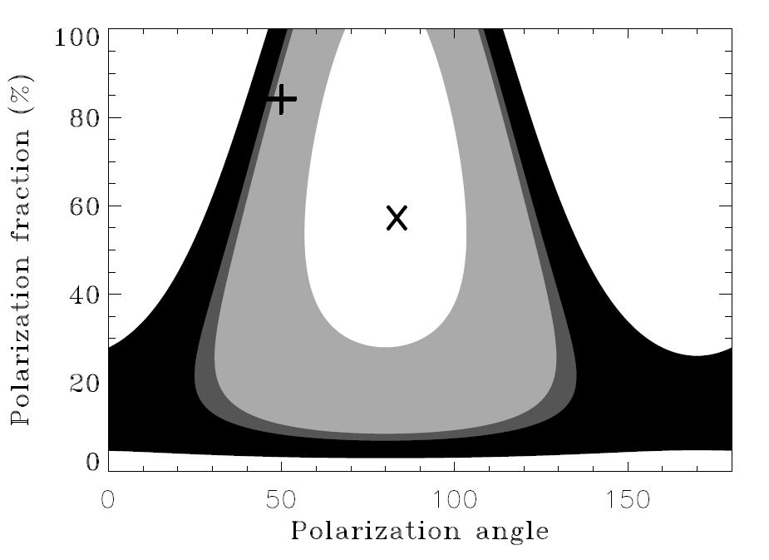
GRB 041219A: measure of Δθ
Comparaison of PA between 2 energy bands with
similar signal to noise
68%
90%
95%
99%
proba(a > a₀, any ϕ) = 0.06 %
June, 13th 2012
GRB polarisation observations

Slide 33
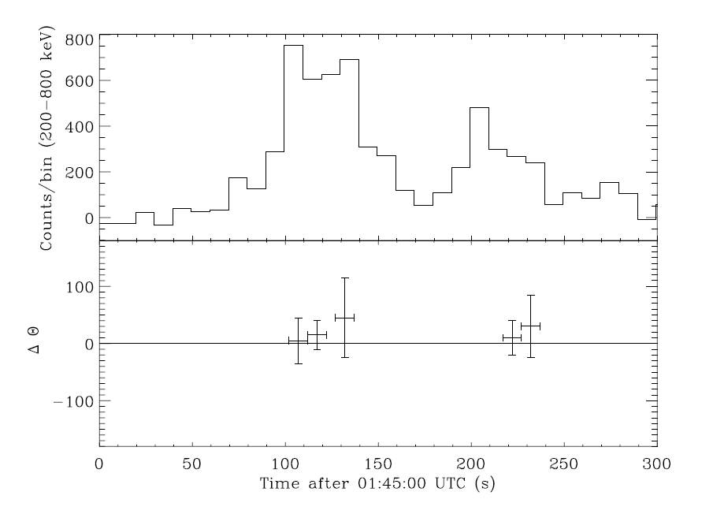
GRB 041219A: constraints on LIV
Comparaison of PA between 2 energy bands
200-250 keV vs
250-325 keV
Δθ = 21 ± 47°
ξ < 4 10⁻¹⁵
June, 13th 2012
GRB polarisation observations

Slide 34
IKAROS/GAP GRB observations
June, 13th 2012
GRB polarisation observations

Slide 35
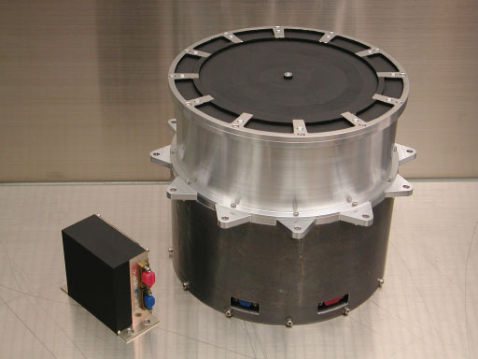
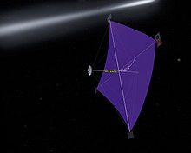
The IKAROS/GAP experiment
Japanese experiment launched in2010.
GAP : Gamma-Ray Burst polarimeter on the solar sail IKAROS.
Plastic – CsI axial Compton telescope.
Heavily tested on ground in polarized beams.
June, 13th 2012
GRB polarisation observations

Slide 36
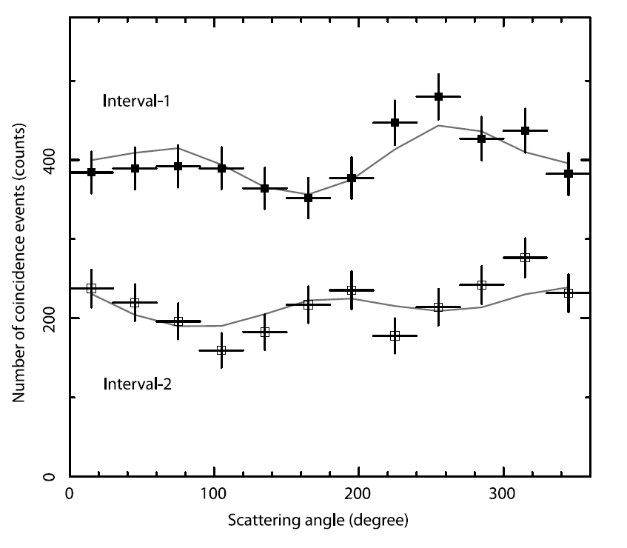
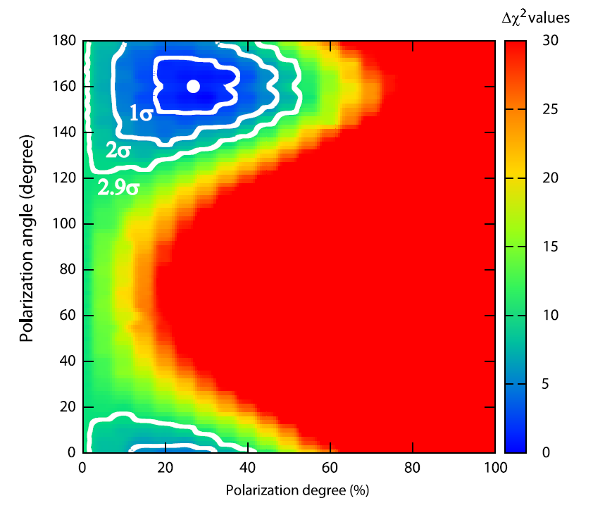
GAP observation of GRB 100826A
GRB 100826A observed by GAP (70 – 300 keV).
Modulation fitted with a Monte-Carlo model.
Marginal detection at 2.9 σ
June, 13th 2012
GRB polarisation observations

Slide 37
FUTURE MISSIONS …
June, 13th 2012
GRB polarisation observations

Slide 38
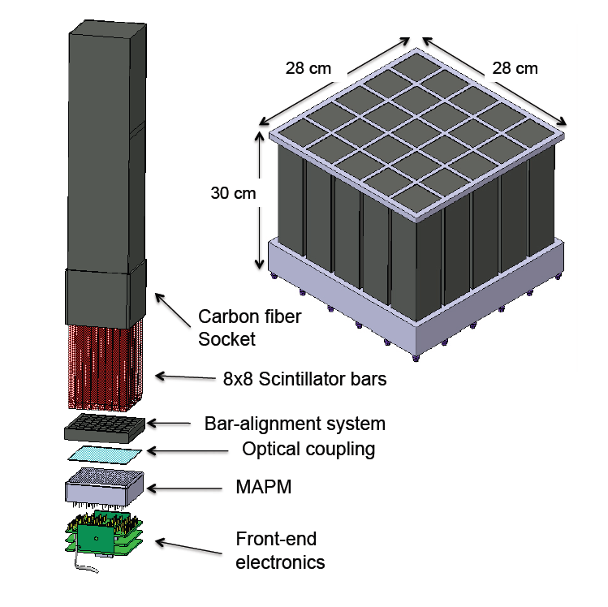
The POLAR telescope (2014)
POLAR is a Swiss lead mission to be placed on the Chinese space station Tiangong 2 (2014).
It is a Compton telescope dedicated to GRB polarization measures.
It consists of several bars of plastic scintillator readout by PMT (a₁₀₀ ~ 60 %).
June, 13th 2012
GRB polarisation observations

Slide 39
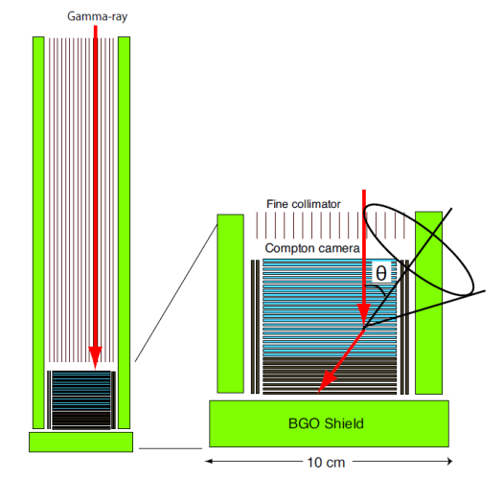
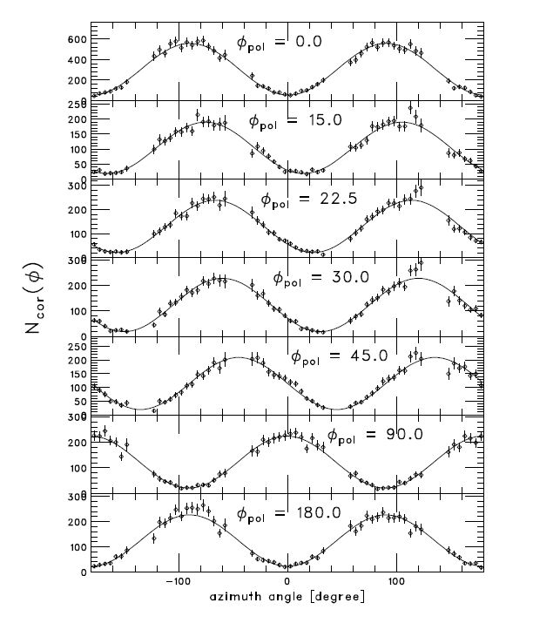
Astro-H (2014)
Astro-H : next X-ray Japanese mission
4 instruments including a Compton telescope (SGD, 5-600 keV).
Good polarimetric results on ground.
But, FOV (10°), delimited at high energy (> 300 keV) by BGO collimators.
250 keV X-ray beam
SGD telescope
June, 13th 2012
GRB polarisation observations

Slide 40
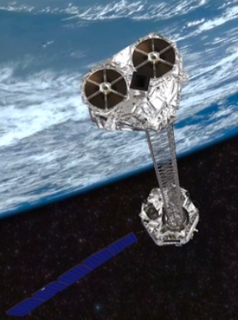
NuStar (2012)
NuStar : new hard X-ray focusing telescope (6-80 keV) to be launched today (20h30 Moscow time).
A mirror focuses X-rays toward a CZT detector, 12 m away.
Polarization measures could be made by studying Compton scatter between different CZT pixels.
But, small FOV ⇒ GRB scarcely observed.
June, 13th 2012
GRB polarisation observations

Slide 41
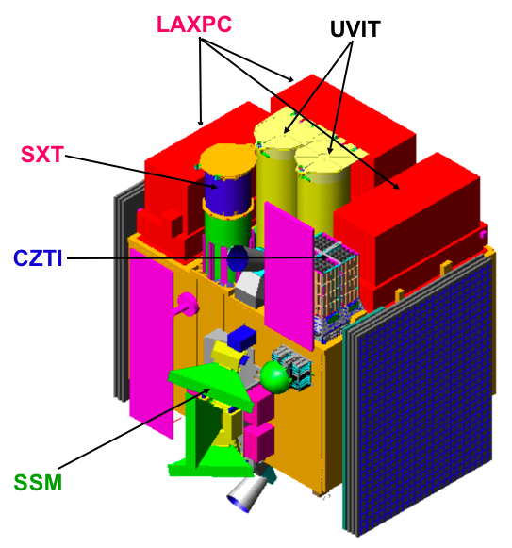
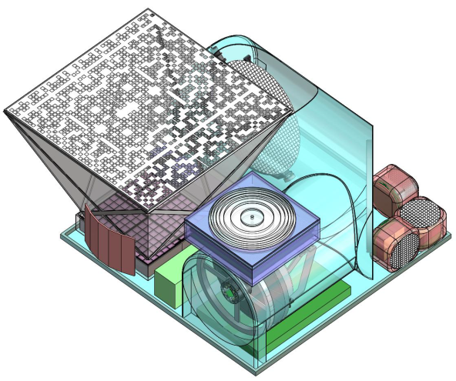
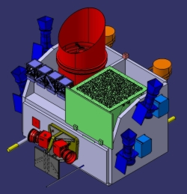
ASTROSAT (2012), UFFO-100 (2015), SVOM (2017), …
ASTROSAT : next X-ray/UV indian mission
UFFO-100 : russian/korean mission
SVOM : French/Chinese GRB mission
hard X-ray wide field imager: CZT, LSO detector + coded mask which may be also used as “90° polarimeters”.
June, 13th 2012
GRB polarisation observations

Slide 42
Conclusion
The measure of polarization in hard-X/soft-gamma rays is a powerful tool to investigate the emission mechanisms and geometry of Gamma-Ray Bursts.
Fundamental physics questions can also be addressed
Next generation polarimeters (e.g., POLAR, Astro-H, etc.) will complement the present discoveries !
Several Compton telescope R&D projects are on-going all over the world dedicated to hard X-ray polarimetry measurement.
June, 13th 2012
GRB polarisation observations

Slide 43
Thank you !
June, 13th 2012
GRB polarisation observations

Slide 44
Interpretation(s)
synchrotron emission from shock accelerated electrons in a relativistic jet with magnetic field transverse to the jet expansion (Granot 2003, Granot & Königl 2003, Nakar, Piran & Waxman 2003)
(ii) synchrotron emission from purely electromagnetic flow
(Lyutikov et al. 2003, Nakar, Piran & Waxman 2003)
(iii) synchrotron emission from shock accelerated electrons in a relativistic jet with a random magnetic field (Ghisellini & Lazzati 1999, Waxman 2003)
SAME POLARIZATION LEVELS AS IN (I) BUT A PECULIAR OBSERVATION CONDITION IS NEEDED (Θobs ≅ Θjet+k/Γ)
June, 13th 2012
GRB polarisation observations

Slide 45
Interpretation(s)
(iv) Inverse Compton scattering from relativistic electrons in a jet propagating in a photon field (“Compton drag”) (Lazzati 2004)
POLARIZATION LEVELS can reach 60-100% BUT ONLY UNDER THE CONDITION OF A NARROW JET (ΓΘjet<5) AND THE SAME OBSERVATION CONDITIONS AS IN (iii) APPLY
(v) Independently from the emission process (synchrotron or inverse Compton), fragmented fireballs (shotguns, cannonballs, sub-jets) can produce highly polarized emission, with a variable P.A. The fragments are responsible for the single pulses and have different Lorentz factors, opening angles and magnetic domains. (e.g. Lazzati & Begelman 2009)
June, 13th 2012
GRB polarisation observations

Slide 46
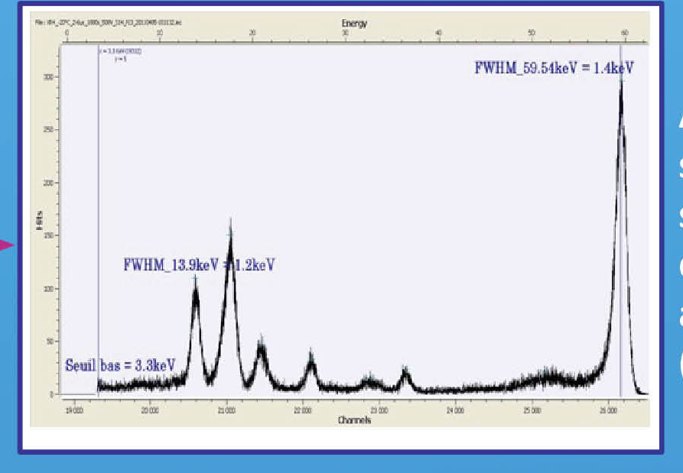

Slide 47
