Slide 1

Aspherical Supernova Explosion and
Gamma-Ray Bursts
Shigehiro Nagataki
ExUL-2012 GRB Workshop:
Gamma-Ray Bursts: Probing the Science, Progenitors and their Environment
Moscow, Russia, June 13th-17th

Slide 2
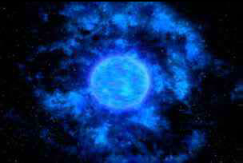
Movie of a Long GRB (Imagination)
From NASA’s HP.

Slide 3
History of the Numerical Study on the Central Engine of Long-GRBs.
P.Kumar’s talk on Wednesday
First report on the association of a GRB with a hypernova was done in 1998.
Rotating Black Hole with Neutrino Heating?
Rotating Black Hole with Strong B-Fields ?
Rotating Neutron Star with Strong B-Fields?
Outline of Explosion Mechanism is still under debate.
BH (Collapsar) or NS (Magnetar)?
Neutrino or B-Field?

Slide 4
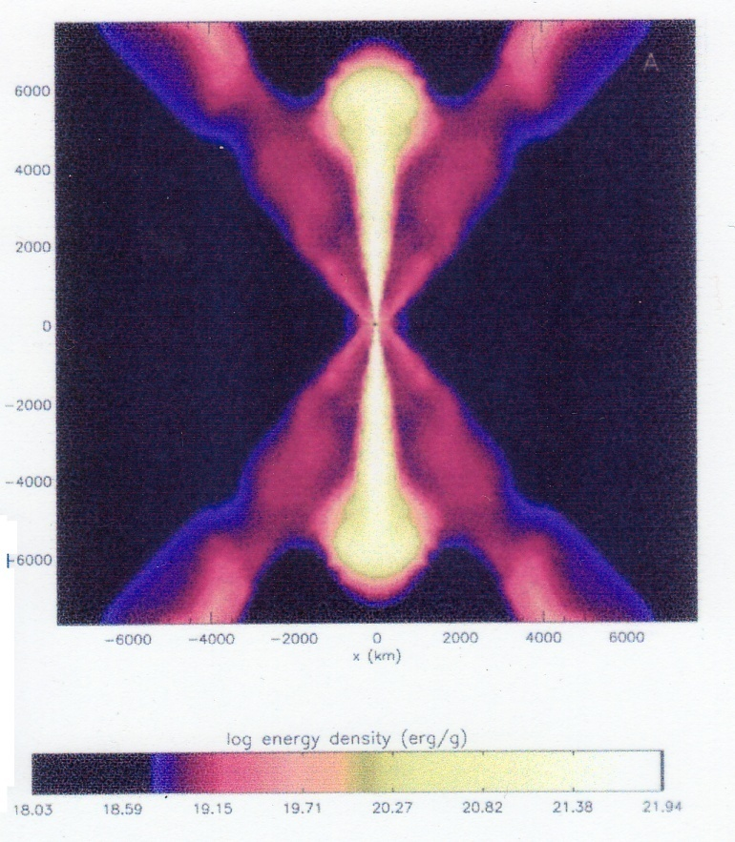
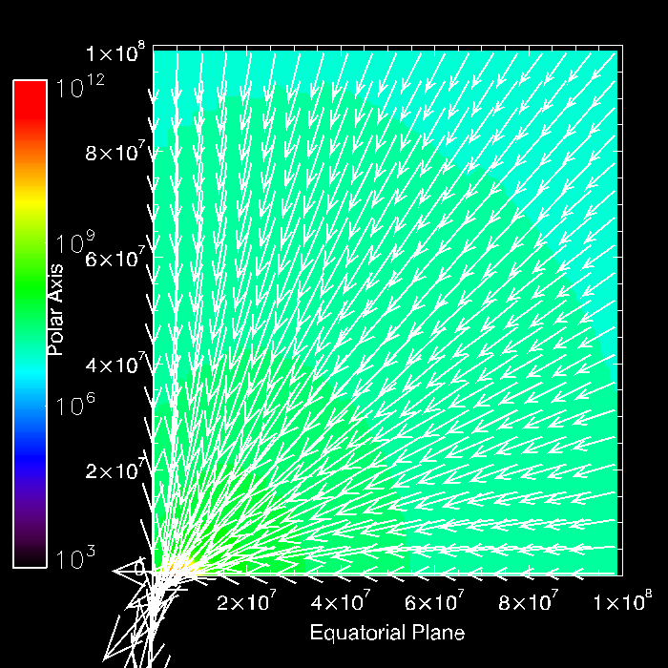
Black Hole with Neutrino Heating
MacFadyen and Woosley 99
Newtonian
Without Neutrino physics
S.N.+07
Newtonian
With some Neutrino physics.

Slide 5
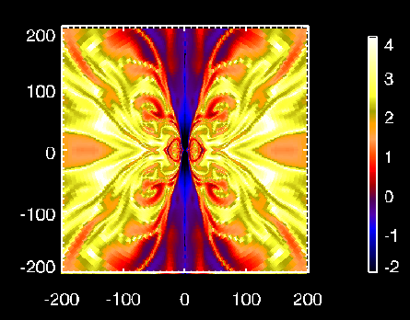
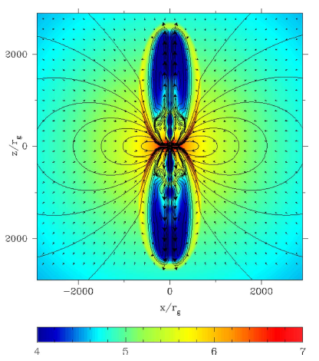
Black Hole with Strong B-Fields
S.N. 09
2D-GRMHD, a=0.5
Without Microphysics.
Plasma beta.
Barkov and Komissarov 08
2D-GRMHD, a=0.9
With Some Microphysics
Γ< a few. Density Contour.
Γ< a few.

Slide 6
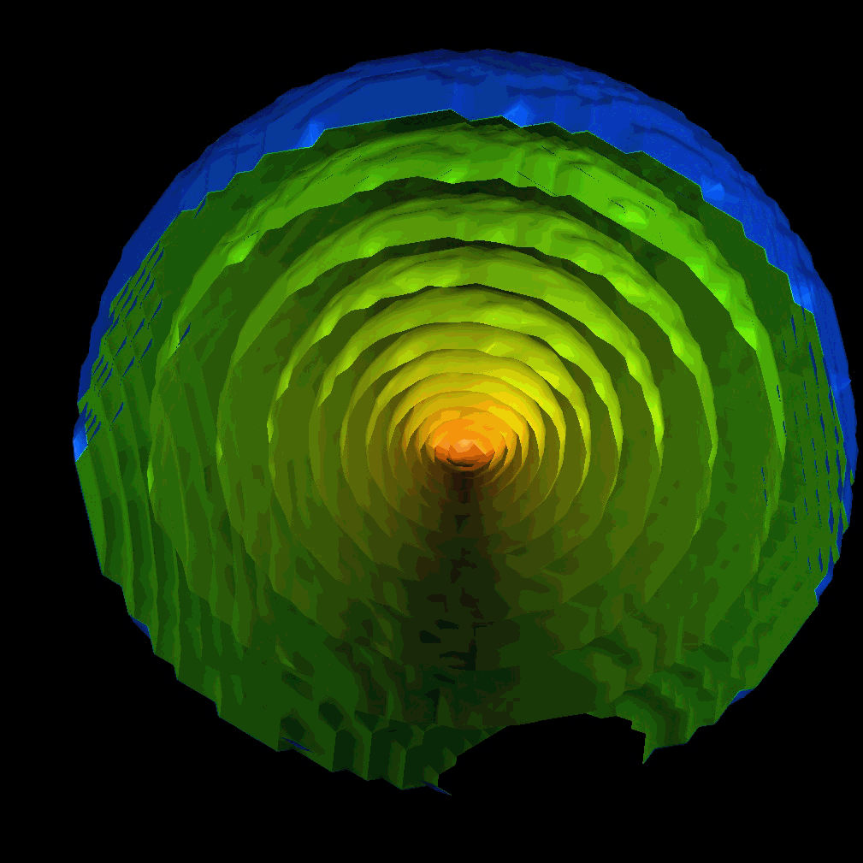
3D-GRMHD Simulation
S.N. 2012, in prep.
～3000km

Slide 7
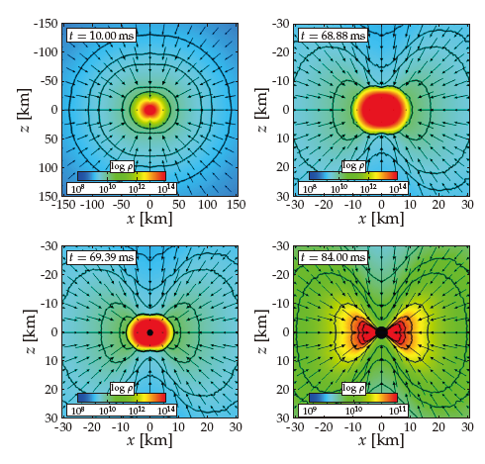
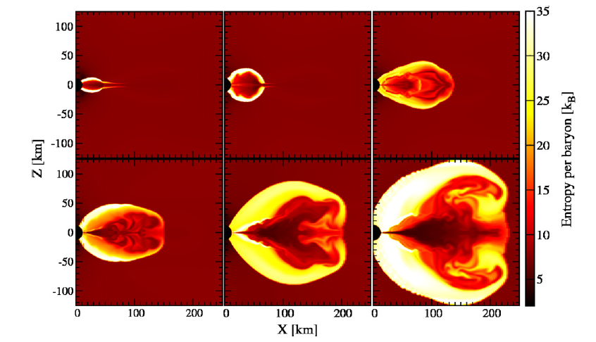
Black Hole Formation
Full 2D-GRHD with Microphysics
Full 3D-GRHD without Microphysics
Sekiguchi and Shibata 11
Ott+11

Slide 8
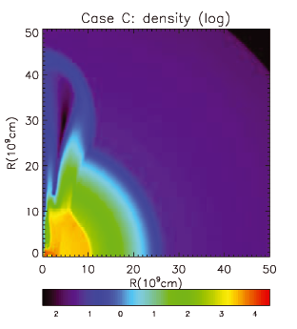
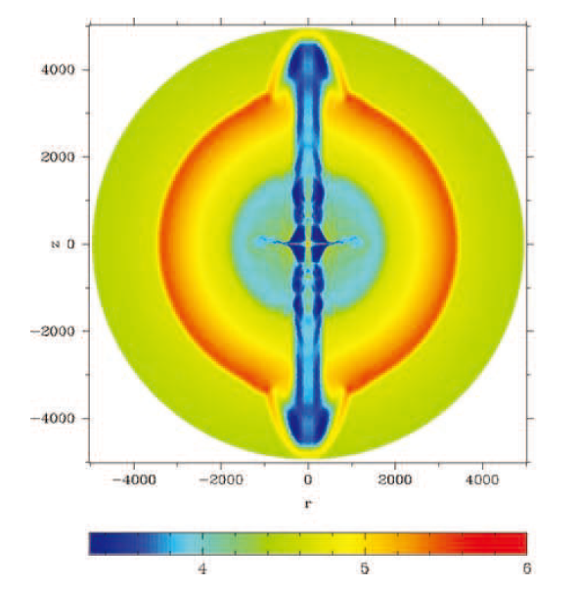

Magnetar Scenario
Komissarov and Barkov 07
2D-GRMHD with some Microphysics
Bucciantini+09
2D-SRMHD without Microphysics
Lorentz factor = 5-10
～0.5.

Slide 9
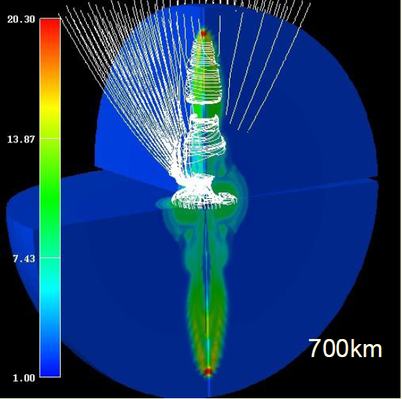
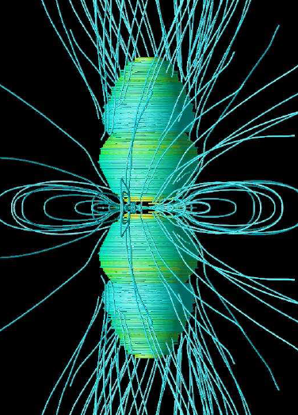
Magnetar Formation
S.Moiseenko’s talk on Wednesday
Takiwaki et al. 09
SRMHD, Neutrino Physics,
Realistic EOS. Upto 100ms. Γ< a few.
See also Takiwaki,Kotake,S.N.,Sato 04.
Burrows et al. 07
Newtonian-MHD, Neutrino Physics&EOS. Upto 0.5-0.6sec.

Slide 10
§ Study on a Rotating Black Hole with Strong B-Fields by a General Relativistic Magneto-Hydrodynamic (GRMHD) code
2D/3D GRMHD Codes with MPI.
2D/3D SRMHD with AMR & MPI.
S.N. ApJ (2009).
S.N. PASJ (2011).
S.N. 2012, in prep.
YukAwa institute’s MAgneTO-hydro (YAMATO) code
YAMATO (大和) =Old Name of Japan
GRMHD Code is necessary to see Blandford-Znajek Process.

Slide 11
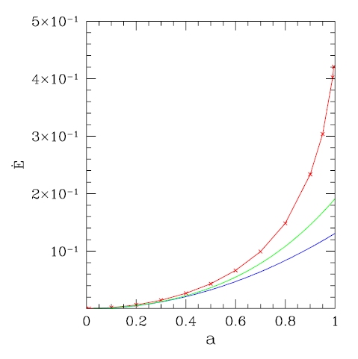
Blandford-Znajek Process can be seen Numerically Now
Blandford and Znajek 1977
Tanabe and S.N. PRD 2008
Red:Numerical
Blue:Analytical
（2nd order）
Green:Analytical
(4th order)
(Split-) Monopole Solution.
C:Amplitude of B-Field. a: Kerr-Parameter.
This solution can be used to check the validity of numerical codes.
Numerical Simulation is necessary for large a and different B-fields.

Slide 12


Initial Condition for GRB Simulations
S. N. 09
Fastly Rotating Massive Stellar Model (12TJ) by Woosley and Heger 2006.
Fe core (1.82Msolar) is extracted and a rotating black hole is put instead.
MBH=2Msolar, a=0.5 (Fixed Kerr Metric).
Minimum value of

Slide 13
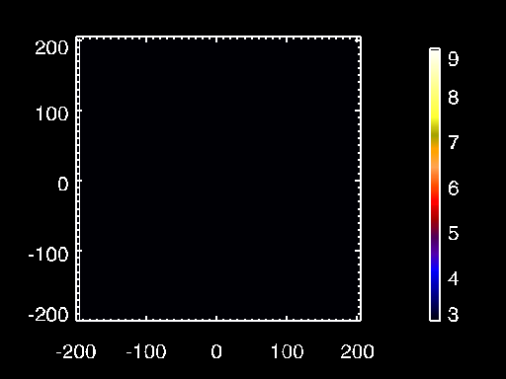
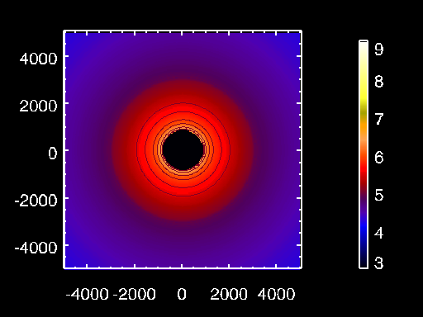
Simulation of a Collapsar
S.N. 2009
C=G=M=1 Unit
～600km
～15000km
Density contour in logarithmic scale (g/cc)
Dynamics is followed up to 1.77sec from the collapse.

Slide 14
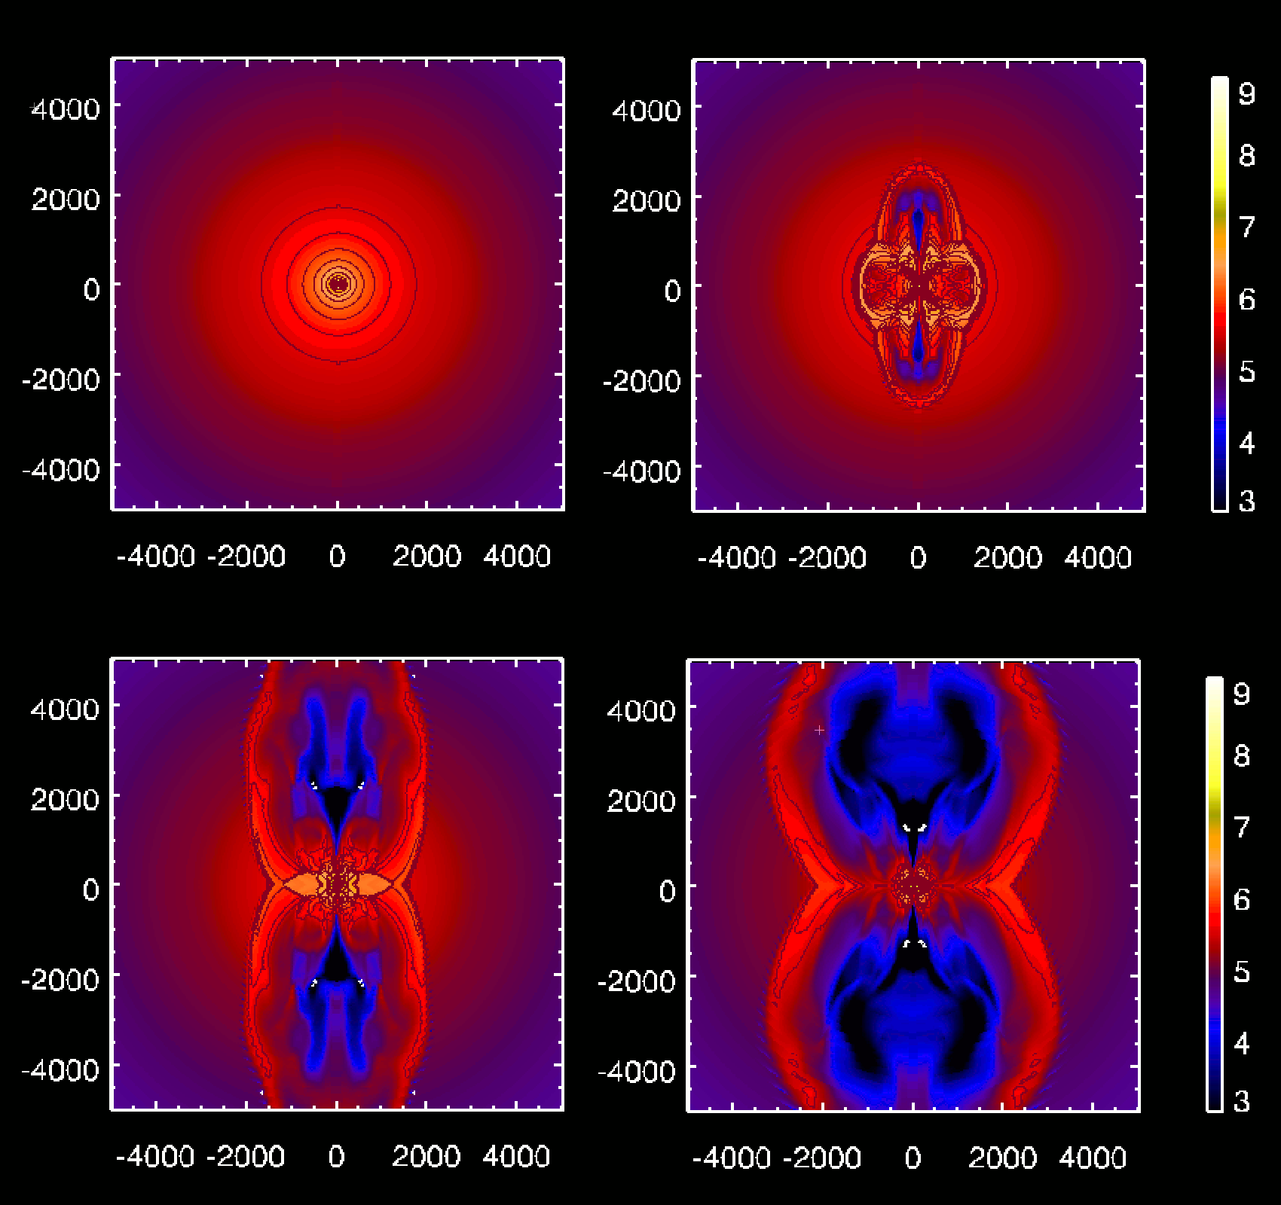
Dependence of Dynamics on Rotating Black Hole
a=0
a=0.5
S.N. 2011
Density Structure
at T=1.6sec.
～15000km
a=0.9
a=0.95

Slide 15
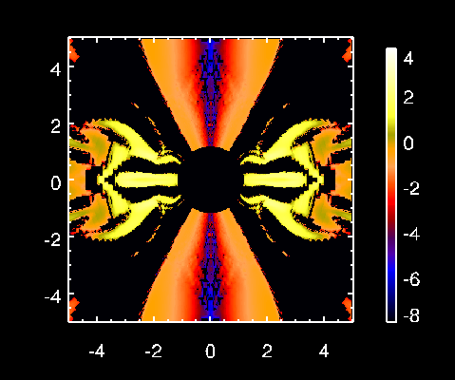
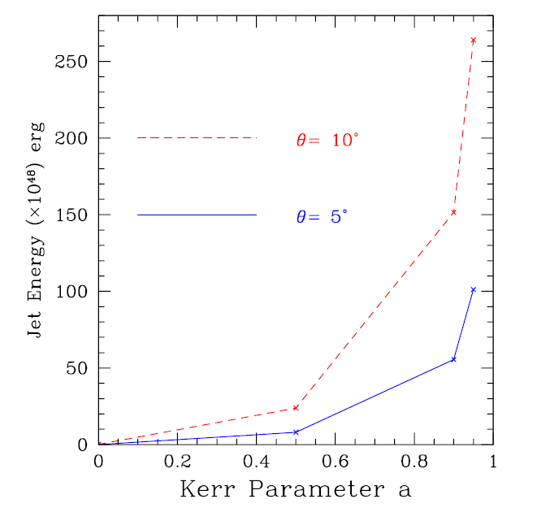
Blandford-Znajek Flux and Jet Energy
S.N. 2011
Faster is Better
～12km
BZ (outgoing poynting)-Flux
In unit of 10^50 erg/s/Sr at
T=1.5760sec.
Kerr Parameter, a=0.95.
Jet Energy at t=1.5750 sec for a=0,
0.5, 0.9, 0.95 (Solid Curves).

Slide 16
3D-GRMHD Simulation of GRBs
S.N. 2012, in prep.
256×256×32
a=0.9
～3000km

Slide 17
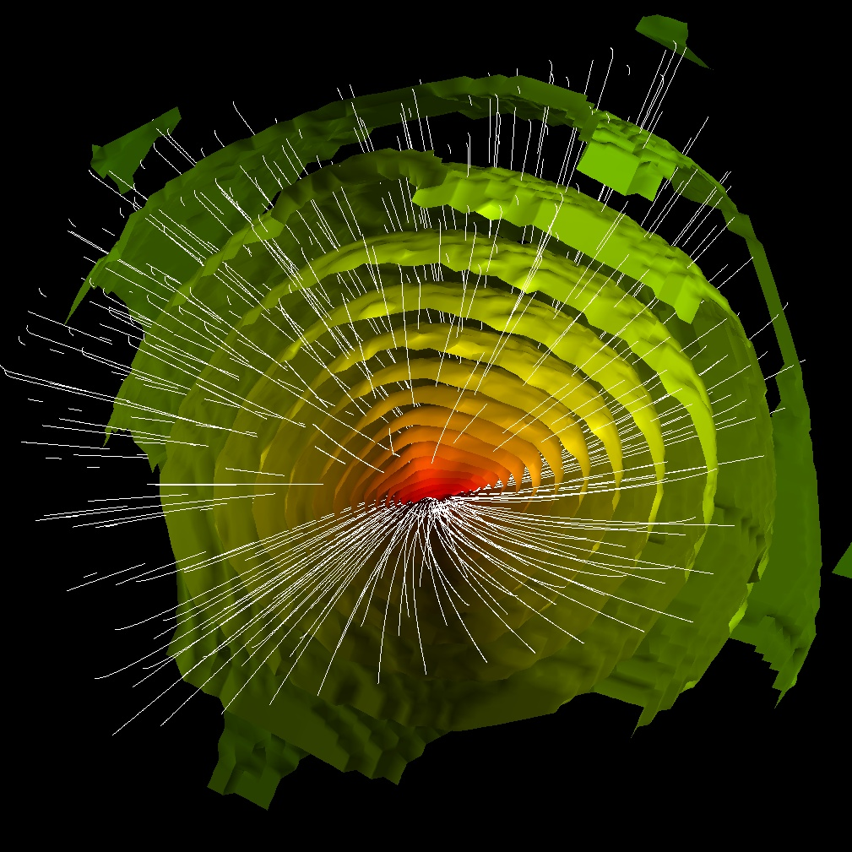
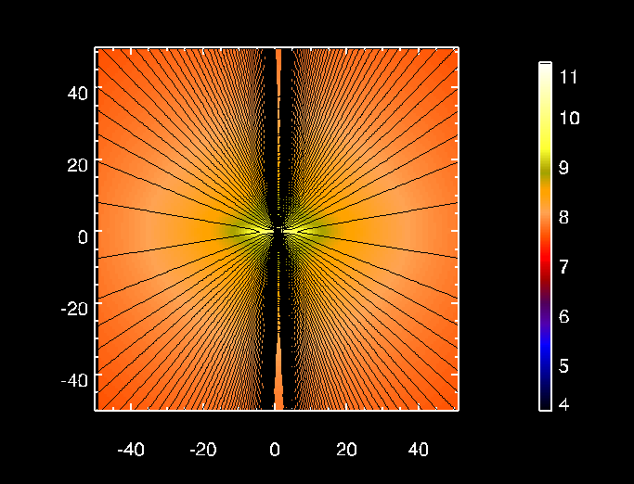
S.N. 2012, in prep.
a=0.9
T～0.8sec
Same Simulations.
Left: 3D Image.
Density+B-fields.
Bottom: 2D Slice
Density+Poloidal
B-Fields
～150km
～150km

Slide 18
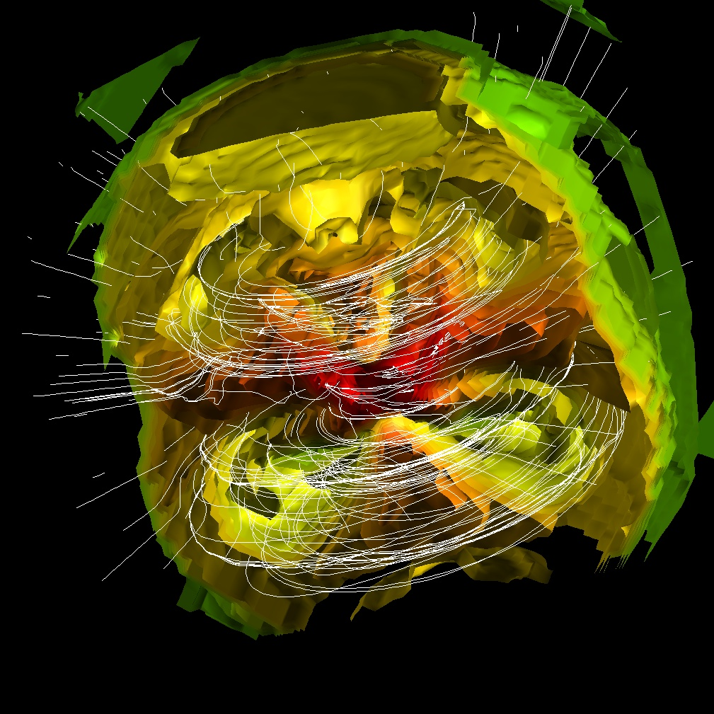
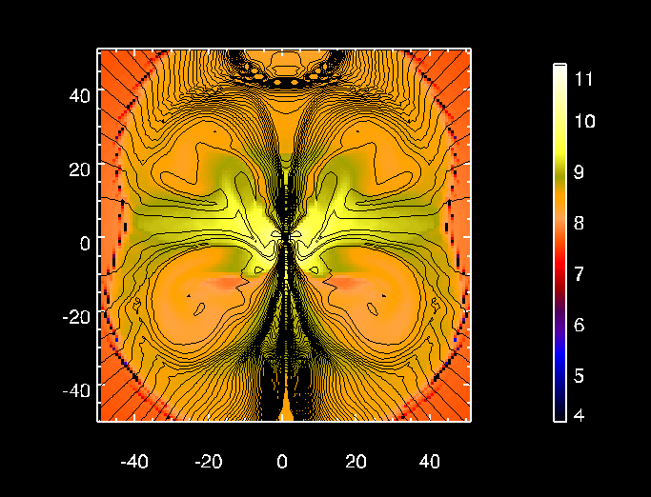
S.N. 2012, in prep.
a=0.9
T～0.85sec
Same Simulations.
Left: 3D Image.
Density+B-fields.
Bottom: 2D Slice
Density+Poloidal
B-Fields
～150km
～150km

Slide 19
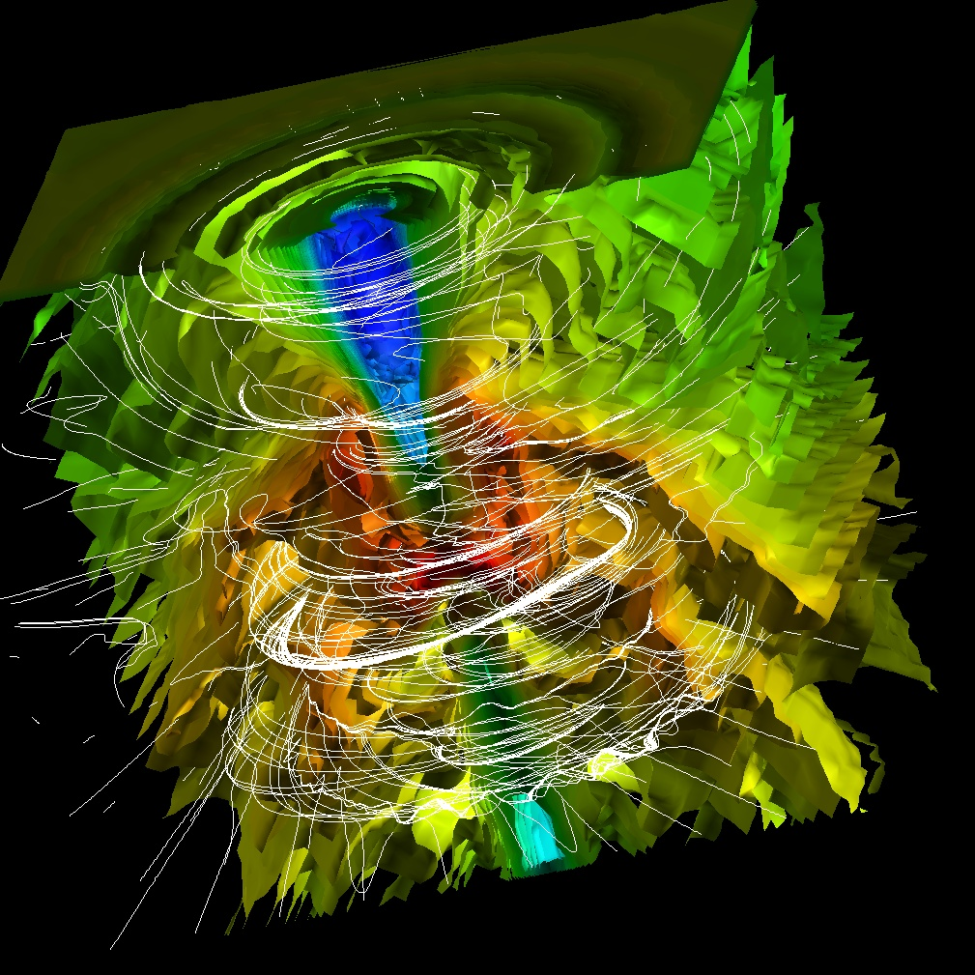
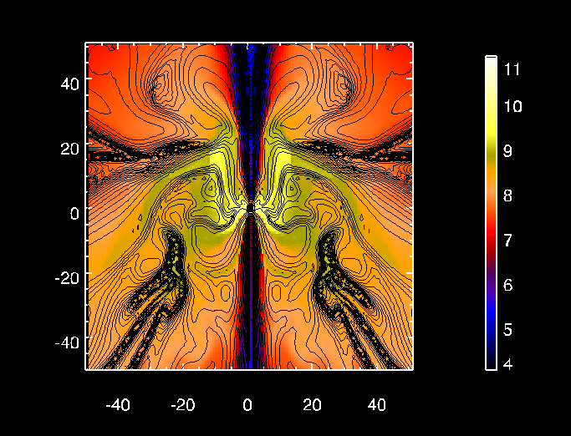
S.N. 2012, in prep.
a=0.9
T～0.9sec.
Same Simulations.
Left: 3D Image.
Density+B-fields.
Bottom: 2D Slice
Density+Poloidal
B-Fields
～150km
～150km

Slide 20
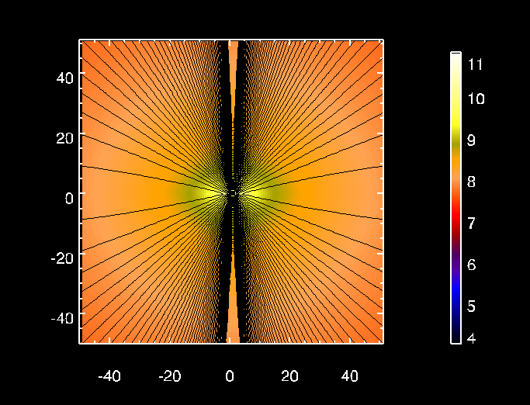
T～0.35sec.
T～0.8sec.
～150km
T～0.85sec.
T～0.9sec.

Slide 21
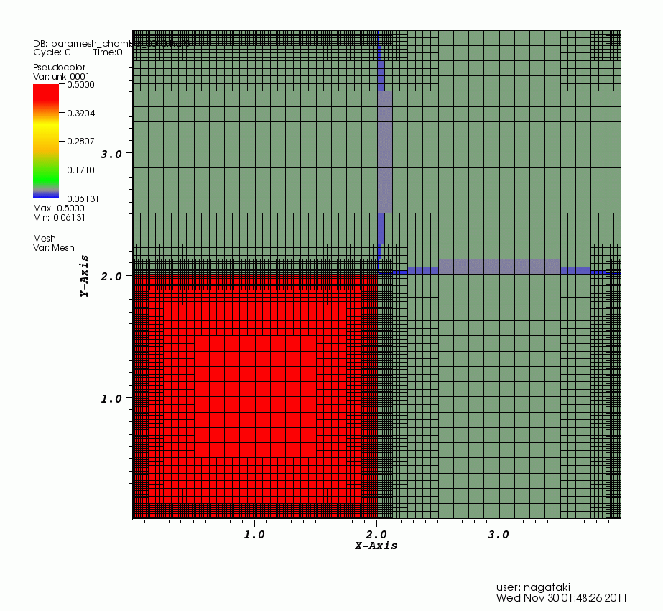
For Fine Resolution Simulations: SRMHD Code with Adaptive Mesh Refinement (AMR)
S.N. 2012, in prep.
Paramesh:
http://www.physics.drexel.edu/~olson/paramesh-doc/Users_manual/amr.html

Slide 22

K(京:10Peta-Flops) Computer is Coming Soon (Sep. 2012-).
548,352 Cores
Memory 8GB per 1Core
100GB/s.

Slide 23
Summary on the Central Engine of LGRBs
Outline of Explosion Mechanism of LGRBs is still under debate. Lots of things to do.
Rotation Energy of a Black Hole can be extracted with a help of Magnetic Fields (Blandford-Znajek Effect).
Faster is better: Rapidly rotating Black Hole can drive an energetic GRB jet.
GRB simulations by 3D GRMHD code are being done. AMR will be attached. 10-Peta Flops Computer will be open very soon.

Slide 24
§Slide Show of Our Studies

Slide 25
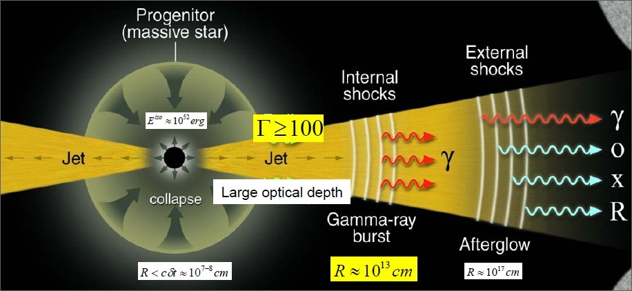
Gamma-Ray Bursts as a Treasure Box of Physics & Mysteries
Kumar’s talk on Wednesday
Photospheric Emission?
Magnetic Dissipation?
?
Nucleosynthesis
Central Engine
GRB/SN
Remnants?
GRB Cosmology?
Figure from P. Meszaros

Slide 26
Explosive Nucleosynthesis in Jet-Induced Supernovae
Calculations of Explosive Nucleosynthesis in Jet-Induced SN were done to explain/predict/find:
Large 44Ti Production that may be Important for SN1987A (Light Curve: S.N.+97) and Cas A (γ-ray Line: S.N.+ 98a: See also Iyudin et al. 94).
Line profile of Iron for SN1987A (S.N.+98b, S.N.00: See also Chugai 91) .
Kick velocity of the Neutron Star in SN1987A (S.N.00).
Split line profile for highly aspherical explosion (S.N. 00)
Correlation between Duration of Explosion and amount of 56Ni for Hypernovae (S.N.+03,06).
Dark SNe associated with GRBs (S.N.+03,06).

Slide 27
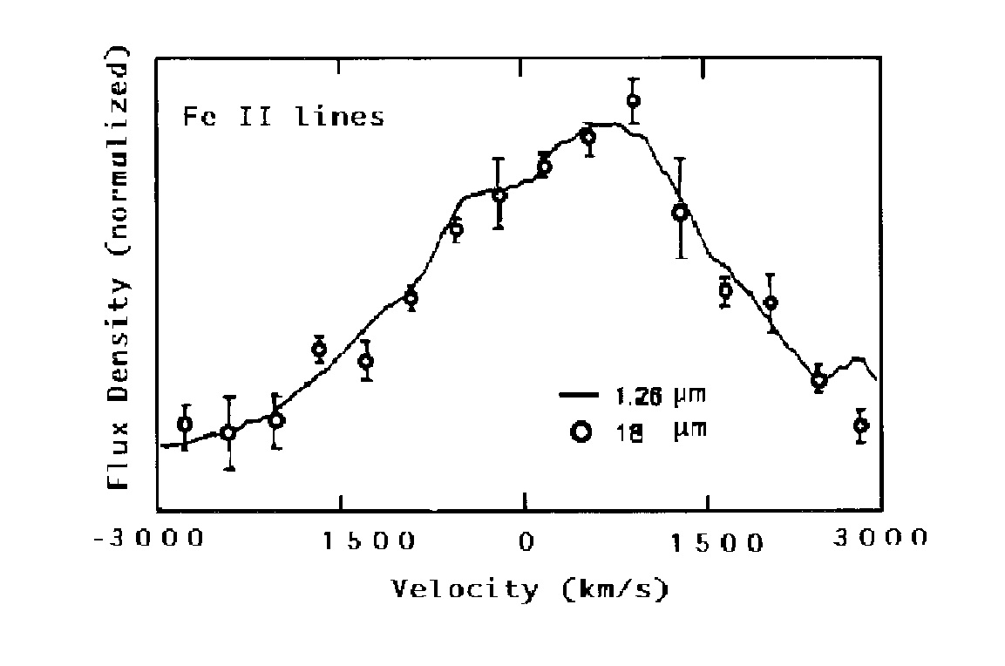
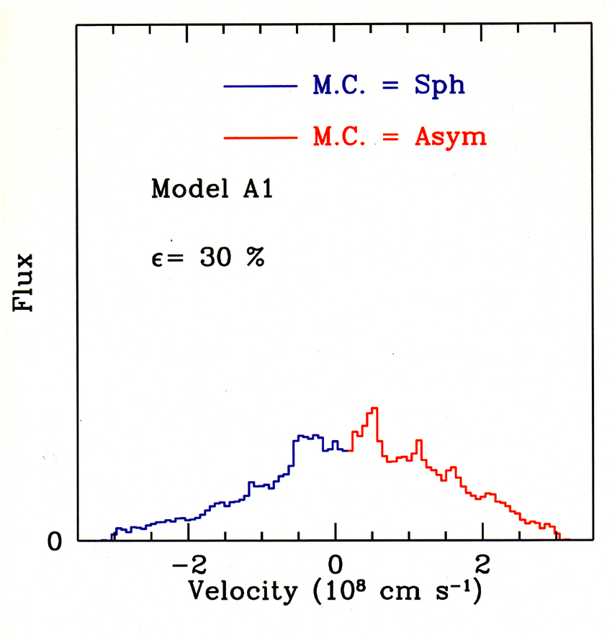
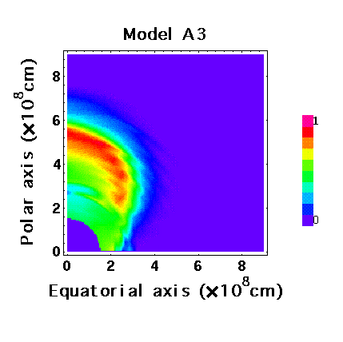
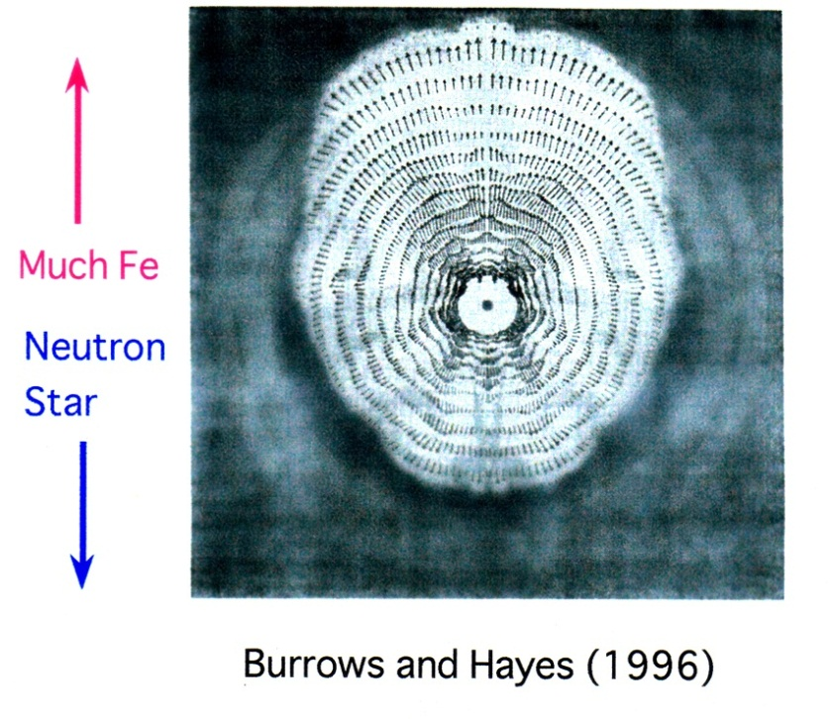
Blue shifted
Red shifted
Calculation:
Iron Velocity
Distribution
SN1987A
Blue shifted
(NS Side)
Red shifted
Haas et al 1990
Mass Fraction of 56Ni
S.N.+97, 98a, 98b, S.N.00

Slide 28
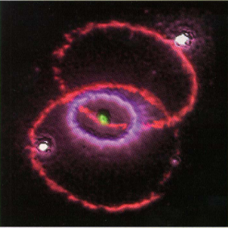
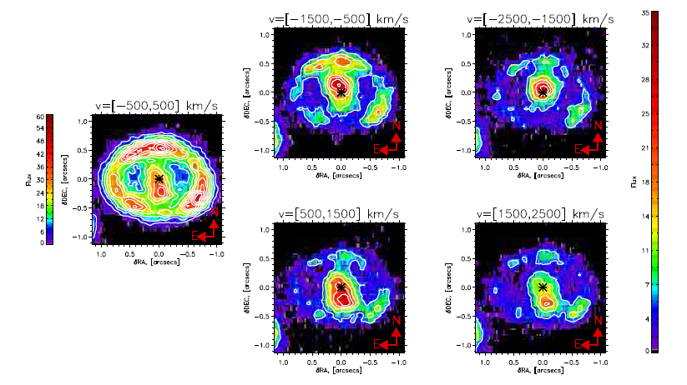
The Missing NS in SN1987A
Should be in the North
S.N.00
Kjaer et al. 2011
Southern part is red-shifted, while northern part is blue-shifted.

Slide 29
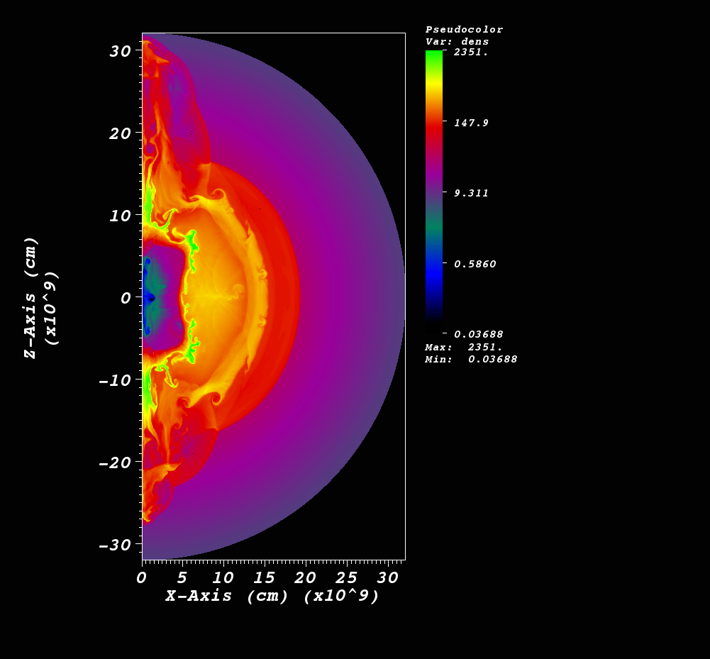
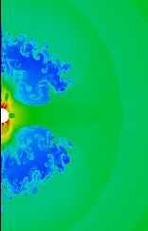
Explosive Nucleosynthesis
in Jet-Like SNe/GRBs by FLASH.
S.N.+ 03, 06.
Ono, S.N.+ 2012, in prep.

Slide 30
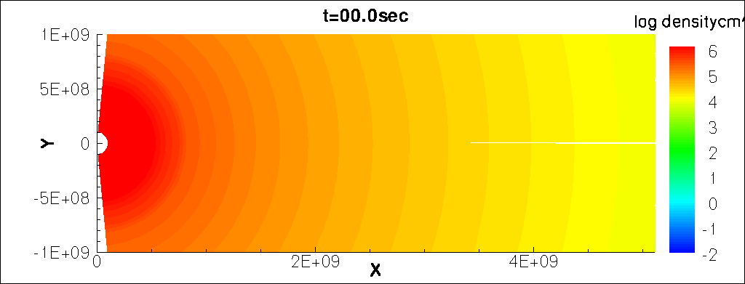
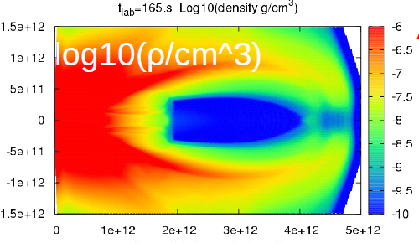
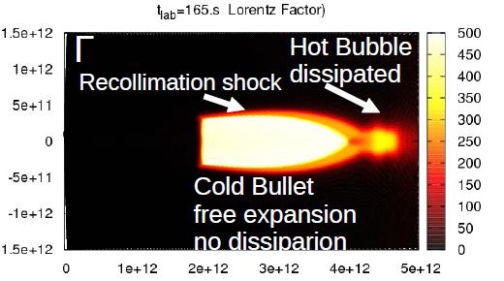
Simulations for the Photospheric Model
Mizuta, S.N., Aoi 2010
Mizuta, S.N., et al. 2012, in prep.

Slide 31
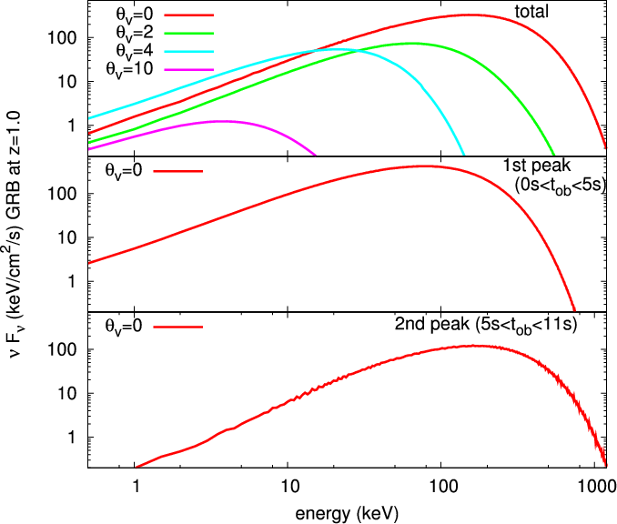
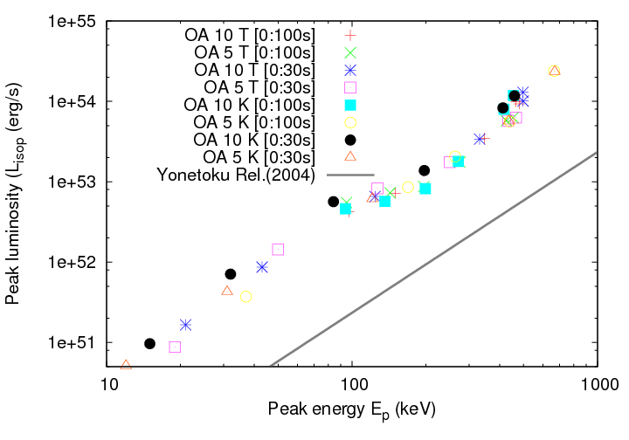
Spectrum, E_peak, and L_peak
Numerical Results
Observed,
Yonetoku
Relation
Superposition of BB spectrum makes the spectrum at low-energy side a little bit softer, although it is not enough to explain alpha.
Yonetoku (and Amati) Relation is almost reproduced except for some systematic difference.

Slide 32
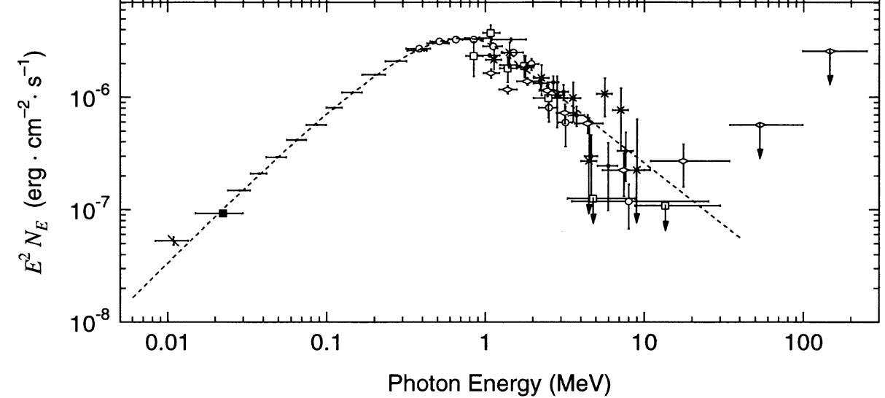
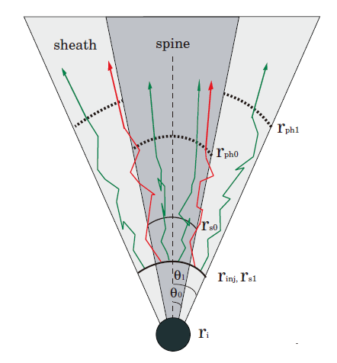
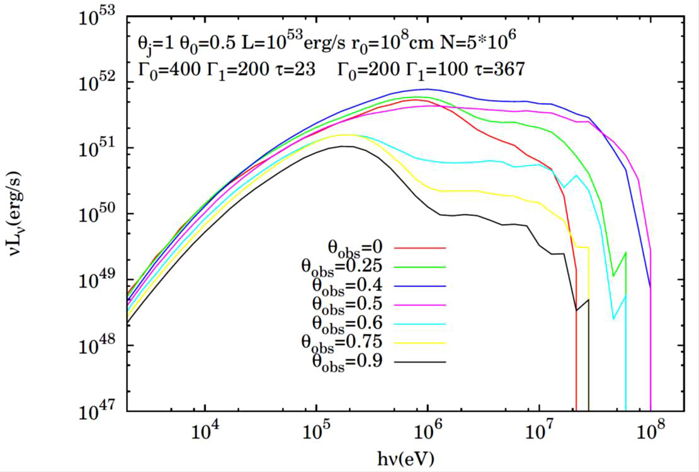
Monte-Carlo Simulations for the Band-Function
Ito, S.N. et al. 2012, in prep.
Band-Function can be reproduced
By structured photospheric model.
Numerical Set-Up &
Monte-Carlo Calculations
Observation
α=0
β=-2.5
α=-1
β=3
Calculation
10keV
1MeV
100MeV

Slide 33
Study on Supernova Remnant
RXJ1713.7-3946 with CR-Hydro-NEI Code
Lee, Ellison, S.N. 2012
Ellison+ 2010 and References there in.
Cosmic Ray-Hydro–Non Equilibrium
Ionization (CR-Hydro-NEI) Code
= Hydrodynamics taking into account
the feedback by CRs with calculation
of NEI.
Our study with the Improved
CR-Hydro-NEI code (Lee, Ellison, S.N.
2012) Confirmed Ellison et al. 2010:
Gamma-Rays look leptonic Origin.
・ To suppress the line emissions
・ To explain the spectrum shape
in GeV-TeV range.
RXJ1713 in TeV-Gamma (Color, HESS)
And X-rays (Contour, ASCA)
Age is about 1600yrs.

Slide 34
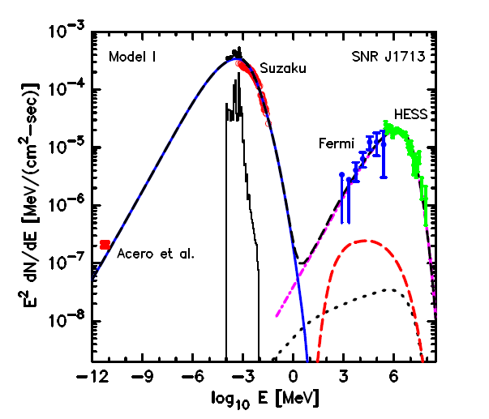
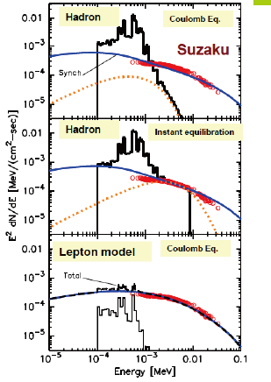
Gamma-Rays look Leptonic Origin for RXJ1713. 7-3946
Lee, Ellison, S.N. 2012
Ellison+ 2010
Sync.
IC
Lines
pp
Brems
Radio
GeV-TeV
Gamma-rays
X-rays

Slide 35
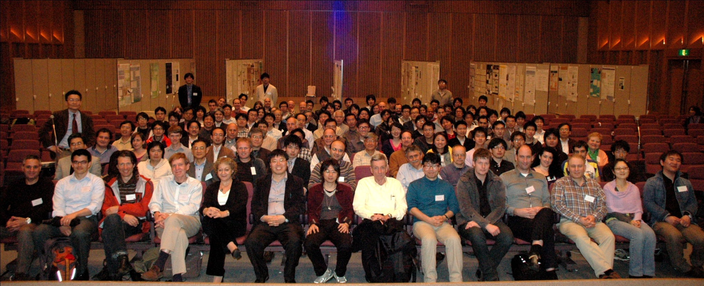
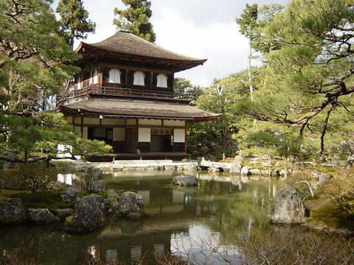
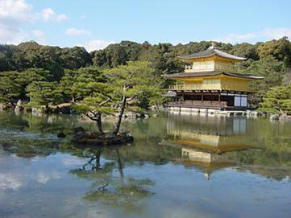
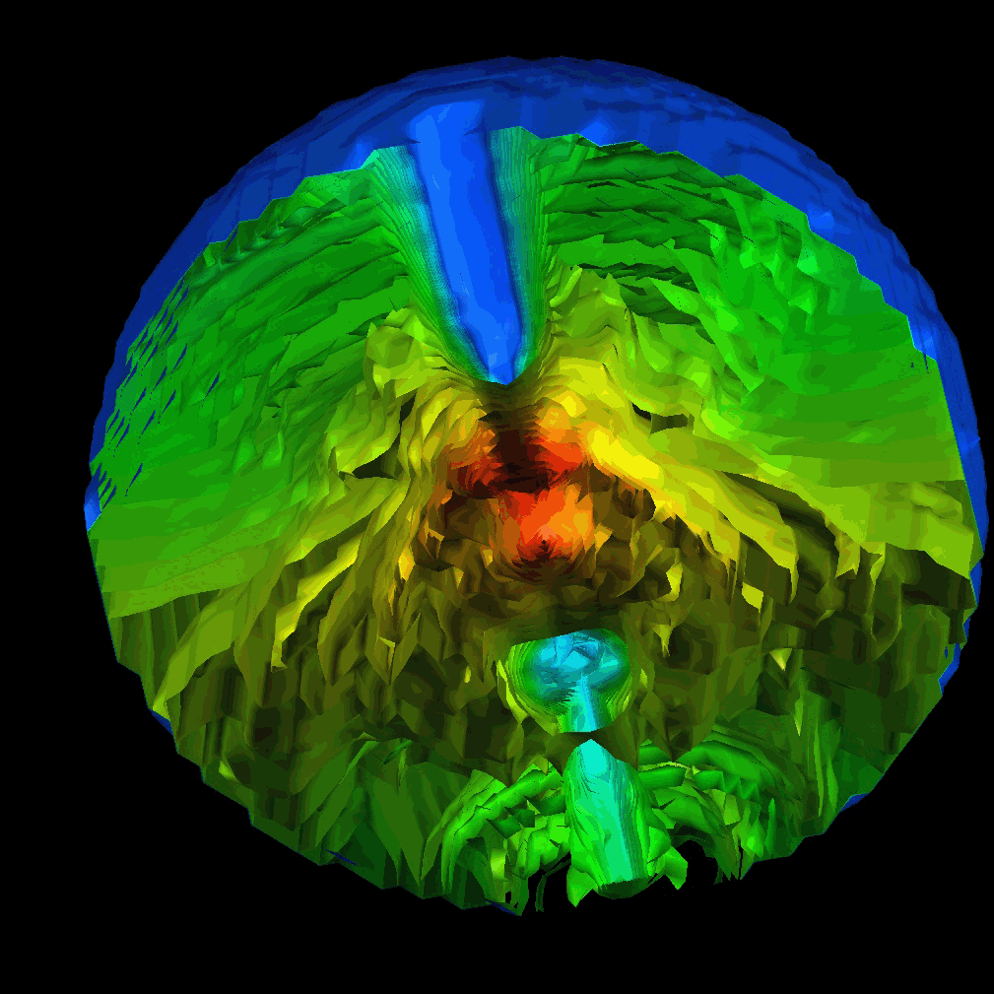

Supernovae and Gamma-Ray Bursts in Kyoto, 2013
Oct.-Nov. in 2013.
2weeks for Conferences (SN and GRB)
3weeks for Workshops (Seminars & Discussions).
Photo from GRB2010, Kyoto
In April.

Slide 36

You can Stay More in Kyoto.
Program for Ph.D Students & Postdocs.
Period: 1-3 Months.
Flight fee & accommodation fee are covered, at least.
・ Some Programs for Visiting Faculties.
・ Some Postdoc Positions will be open.
(YITP, Kyoto Univ. and JSPS).

Slide 37
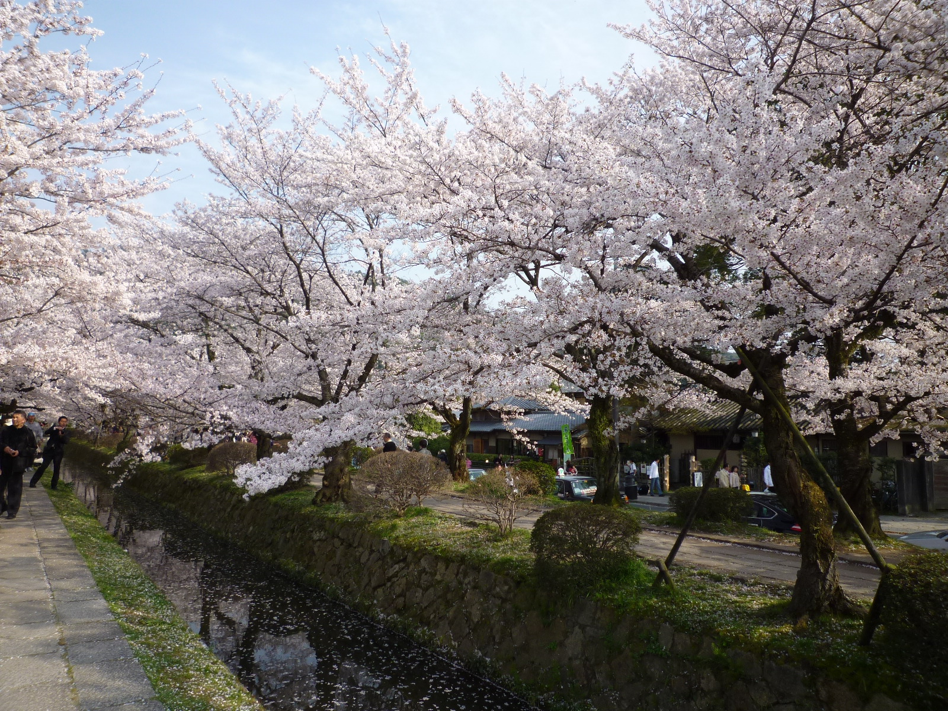
Kyoto in Spring

Slide 38



Kyoto in Summer

Slide 39

Kyoto in Autumn

Slide 40

Kyoto in Winter

Slide 41
Summary
Outline of Explosion Mechanism of LGRBs is still under debate.
Rotation Energy of a Black Hole can be extracted with a help of Magnetic Fields (Blandford-Znajek Effect).
Faster is better: Rapidly rotating Black Hole can drive an energetic GRB jet.
GRB simulations by 3D GRMHD code are being done. AMR will be attached. 10-Peta Flops Computer will be open very soon.
Explosive Nucleosynthesis is being studied by Flash code.
Photosperic Model is studied by Monte-Carlo calculations.
UHECRs, VHE-Neutrinos, SNRs are being studied.
5 Week Conferences and Workshops on SNe and GRBs will be held in Kyoto, 2013, Oct.-Nov.
Programs for Visitors and Postdocs.

Slide 42

Supernovae and Gamma-Ray Bursts in Kyoto, 2013
Oct.-Nov. in 2013.
2weeks for Conferences
(SN and GRB)
3weeks for Workshops
(Seminars & Discussions).

