Slide 1
Jet propagation within the collapsar model
Omer Bromberg¹
Ehud Nakar², Jonathan Granot³
Tsvi Piran⁴, Re’em Sari⁴
Yuri Lubarski⁵, Alexander Tchekhovstoy⁶
1. Princeton University
2. Tel Aviv University.
3. The open University
4. The Hebrew University
5. Ben Gurion University
6. UC Berkeley
Moscow 2013

Slide 2
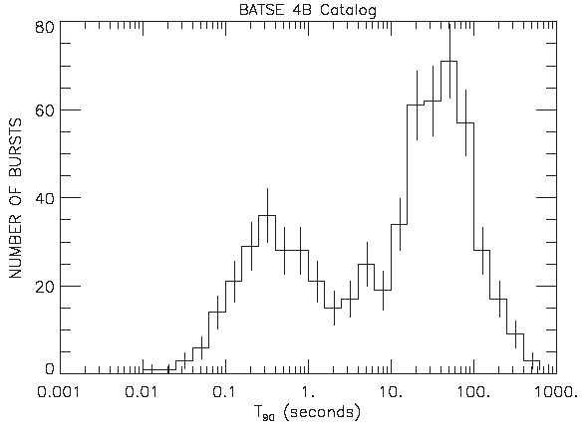
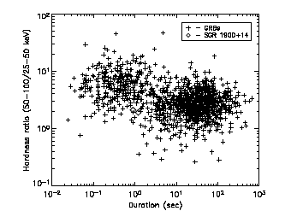
GRB population
Two populations of GRBs – Long and Short*
Long are softer, associated with star forming galaxies and observed at the most active regions.
Short are harder and are associated with a broad population of galaxy types and SFR.
T_{th}=2 sec
Kouveliotou + 93
Kouveliotou + 93

Slide 3


The collapsar model for LGRBs
A star that collapses form a compact object that launches a jet.
The jet drills through the star until it breaks out.
It then accelerates freely and generate the GRB far from the star.
Is there an evidence for the collapsar model?
What is the nature of the compact object at the center?
?

Slide 4
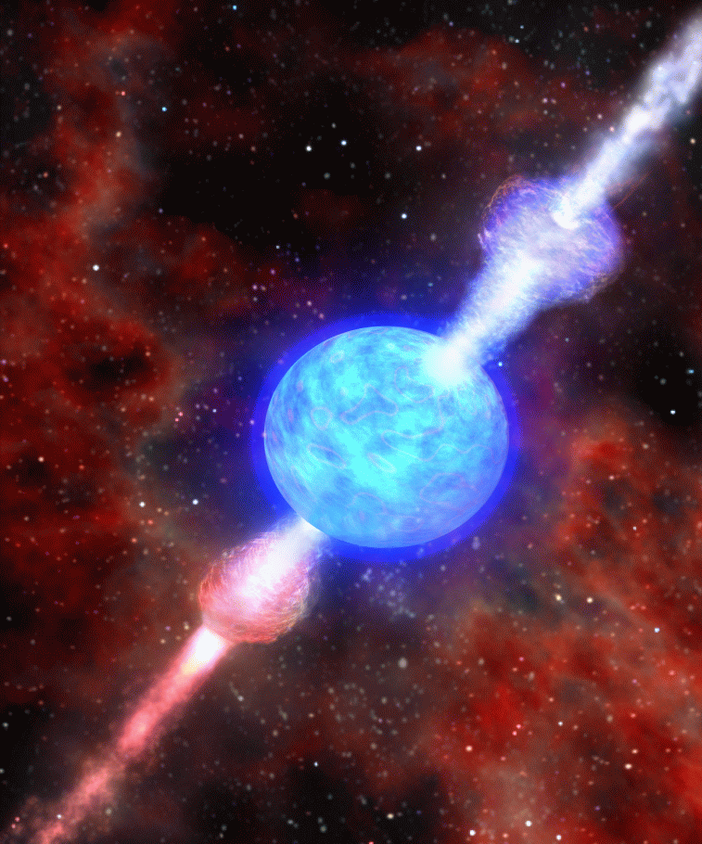
Talk outline
The observational imprint of a jet breakout.
Implications:
  Low luminosity GRBs
  Classification to Colapsars and to non-Collapsars.
The breakout time can indicate on the nature of the compact objet at the center of collapsars.

Slide 5
Jet breakout in Collapsars
A necessary condition for the formation of a GRB in a Collapsar is a successful breakout of the jet.
The observed duration of the GRB is
If the engine stops before the breakout, the jet fails (O.B. et al 2011a).
Failed jets are low luminosity GRBs (O.B. et al 2011b; Nakar & Sari 2012).
Prompt GRB duration time
Jet breakout time
Engine activity time

Slide 6
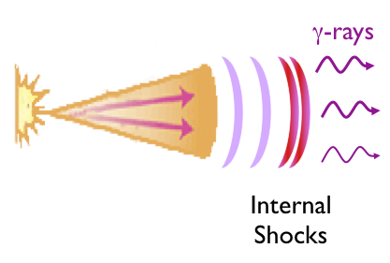
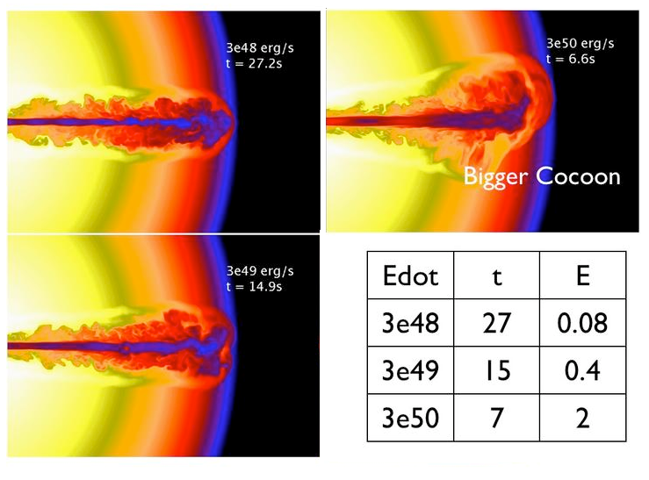
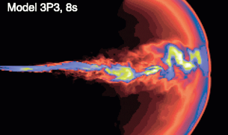
Duration distribution of Collapsars
A single t_{b}:
Two limits:
t_{e}
t_{b}
t_{b}
t_{γ}
t_{e}
t_{e}

Slide 7
Duration distribution of Collapsars
A single t_{b}:
Two limits:
t_{e}
t_{b}
t_{γ}
t_{e}

Slide 8
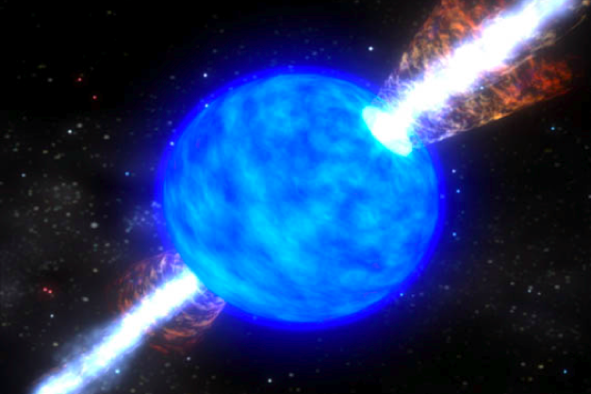
Duration distribution of Collapsars
Short
GRBs
P_{γ}(t_{γ}) ~ dN_{GRB}/dt_{γ}
Non collapsars

Slide 9
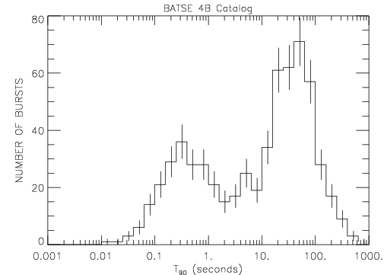
The dN/dT₉₀ distribution of BATSE
Plateau
5-25 sec
Short
Long
dN/dT₉₀
NOT
dN/dlogT₉₀

Slide 10
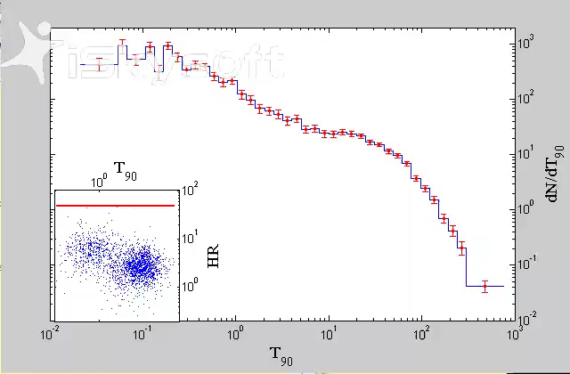
The dN/dT₉₀ distribution of BATSE
Plateau
5-25 sec
Short
Long

Slide 11
The dN/dT₉₀ distribution of BATSE
Plateau
5-25 sec
Short
Long

Slide 12
The dN/dT₉₀ distribution of BATSE
Short
Long
Plateau
5-25 sec
Plateau
0.4-25 sec

Slide 13
Collapsar + non-Collapsars Distribution
Observed plateaus between a few sec to ~20-30 sec
Imply a turnover at T₉₀~40-50 sec and t_{b}~10-15 sec
(O.B. et al 2011c)

Slide 14
Implications: chocked GRBs
The slope at long times ~ p_{e}(t_{e})
Should continue to short times
Extrapolating the slope to T₉₀<50 sec gives a prediction on the rate of events with t_{e}<t_{b}
At t_{e}~0.5t_{b} there are ~ 10 times more chocked GRBs than successful ones.
Considered as a probable source for ‘low luminosity GRBs’.
X10

Slide 15
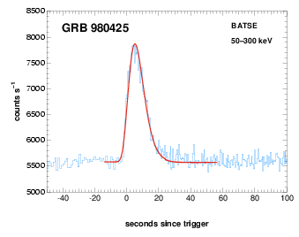
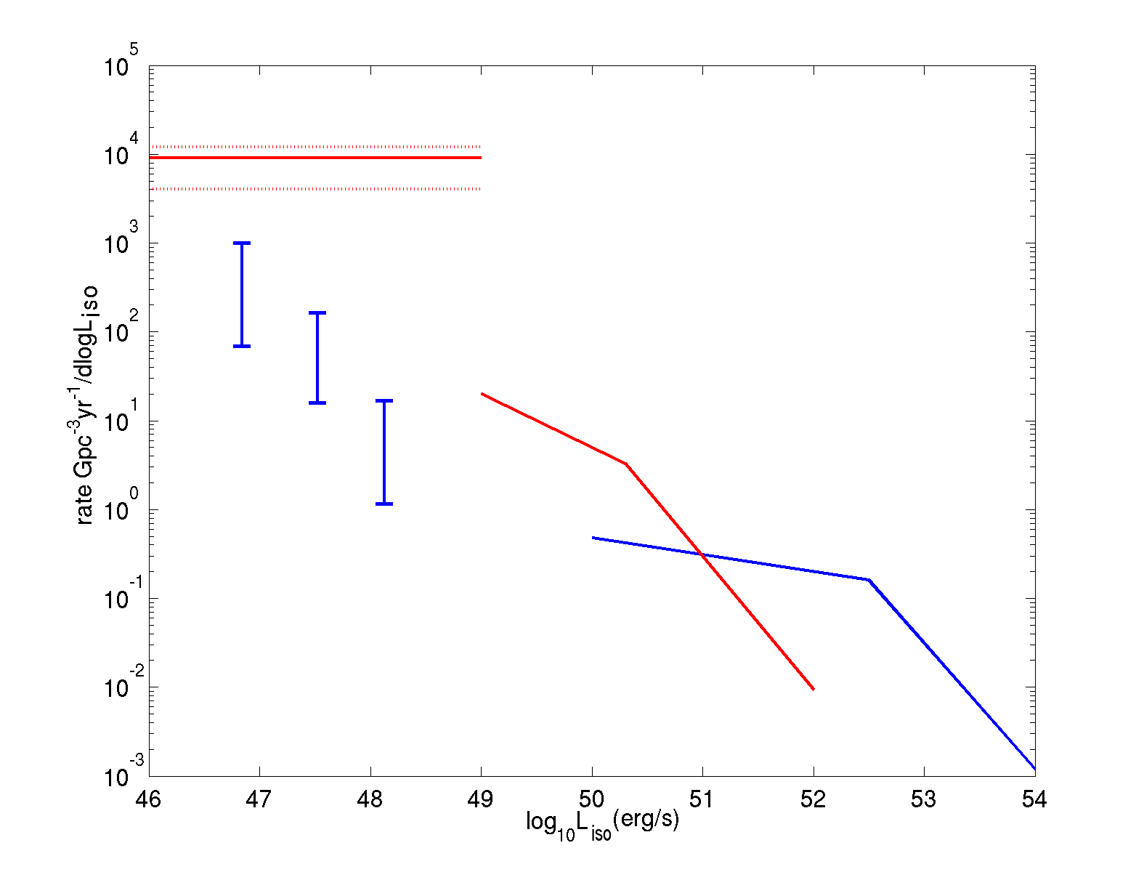
Are low luminosity GRBs Collapsars?
L_{iso}<2·10⁴⁸erg/s.
Smooth single peaked light curve.
Soft Emission (E_{peak} <150 keV)
Rate: ~ 200 Gpc⁻³ yr⁻¹ (~10R_{GRB})
(Soderberg et al. 2006)
Wide opening angle θ>30º (otherwise rate will exceed type Ibc broad line)
But: Almost all are followed by energetic Ic SNe.
T₉₀
SN Ib/c
llGRBs
Short
Long
L_{iso}
n
Wanderman & Piran 2011

Slide 16
Are low luminosity GRBs Collapsars?
Unlike LGRBs most ll-GRBs have T₉₀<<t_{b}.
The T₉₀/(T_{e}) distribution different from that of LGRBs or SGRBs at a probability > 96% (O.B. et al 2011).
In particular it’s not flat (ruled out at a probability > 95%, (O.B. et al 2011 )
Most likely failed jets
(MacFadyen, Woosley, & Heger 2001; Waxman, M´esz´aros, & Campana 2007; Nakar & Sari 2011)
ll-GRBs
LGRBs
SGRBs
100R_{ʘ}
R_{ʘ}
Unlikely to be collapsars
Number of bursts
T₉₀
T₉₀<t_{b}
T₉₀>t_{b}
T₉₀/(T_{e})
L_{iso}
n

Slide 17
Collapsar + non-Collapsars Distribution
(O.B. et al 2011c)

Slide 18
Collapsar + non-Collapsars Distribution

Slide 19
Probability function for non-Collapsars
non-Collapsars
Collapsars
3.1 s
non-Collapsars
Collapsars
0.8 s
non-Collapsars
Collapsars
T₉₀ [s]
1.7 s

Slide 20
The effect of GRB hardness
BATSE
Swift
Fermi

Slide 21
The effect of GRB hardness
BATSE
Swift
Hard
Inter
Soft
Fermi

Slide 22
Duration distributio for non-Collapsars: 3 Hardness groups
BATSE
Swift
T₉₀ [s]
T₉₀ [s]

Slide 23
Probability function for non-Collapsars: T₉₀ + Hardness
BATSE
Swift
f_{NC}
T₉₀ [s]
T₉₀ [s]

Slide 24
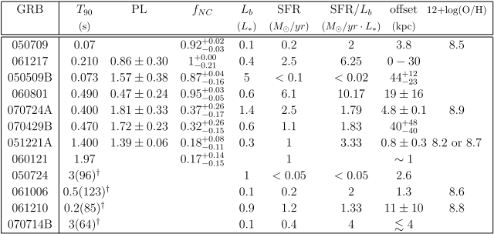
Consistency & Implications I
The environment of short GRBs (Berger 2007)

Slide 25
Consistency & Implications I
The environment of short GRBs (Berger 2007)

Slide 26
Consistency & Implications II
The fraction of non-collapsars in a sample of 18 short GRB (T₉₀<2 sec)
0
0.1
0.2
0.3
0.4
0.5
0.6
0.7
0.8
0.9
1
Probability
Fraction in the sample
0 1 2 3 4 5 6
Wanderman & Piran 2013
Delay time [Gyr]

Slide 27
Consistency & Implications III
The redshift of SGRBs with confirmed host galaxies
non-Collapsars
f_{NC}
Collapsars
060121
090426
120804A
Redshift

Slide 28
Consistency & Implications IV
Why does Integral see only a few SGRBs?
BATSE
INTEGRAL
5 events
dN/dT₉₀
T₉₀ [sec]
Credit: Z. Bosnjak
(Bosnjak et. al. 2012, in prep)

Slide 29
Consistency & Implications IV
Why does Integral see only a few SGRBs?
BATSE
INTEGRAL
dN/dT₉₀
T₉₀ [sec]
Credit: Z. Bosnjak
(Bosnjak et. al. 2012, arxiv 309, 3174)

Slide 30
Consistency & Implications IV
Why does Integral see only a few SGRBs?
BATSE
INTEGRAL
GRBs classification is satellite dependent!
It involves both duration and the hardness.
dN/dT₉₀
Soft triggering ~ 20-200 Kev
Duration distribution similar to Swift!
T₉₀ [sec]
Credit: Z. Bosnjak
(Bosnjak et. al. 2013, arxiv 309, 3174)

Slide 31
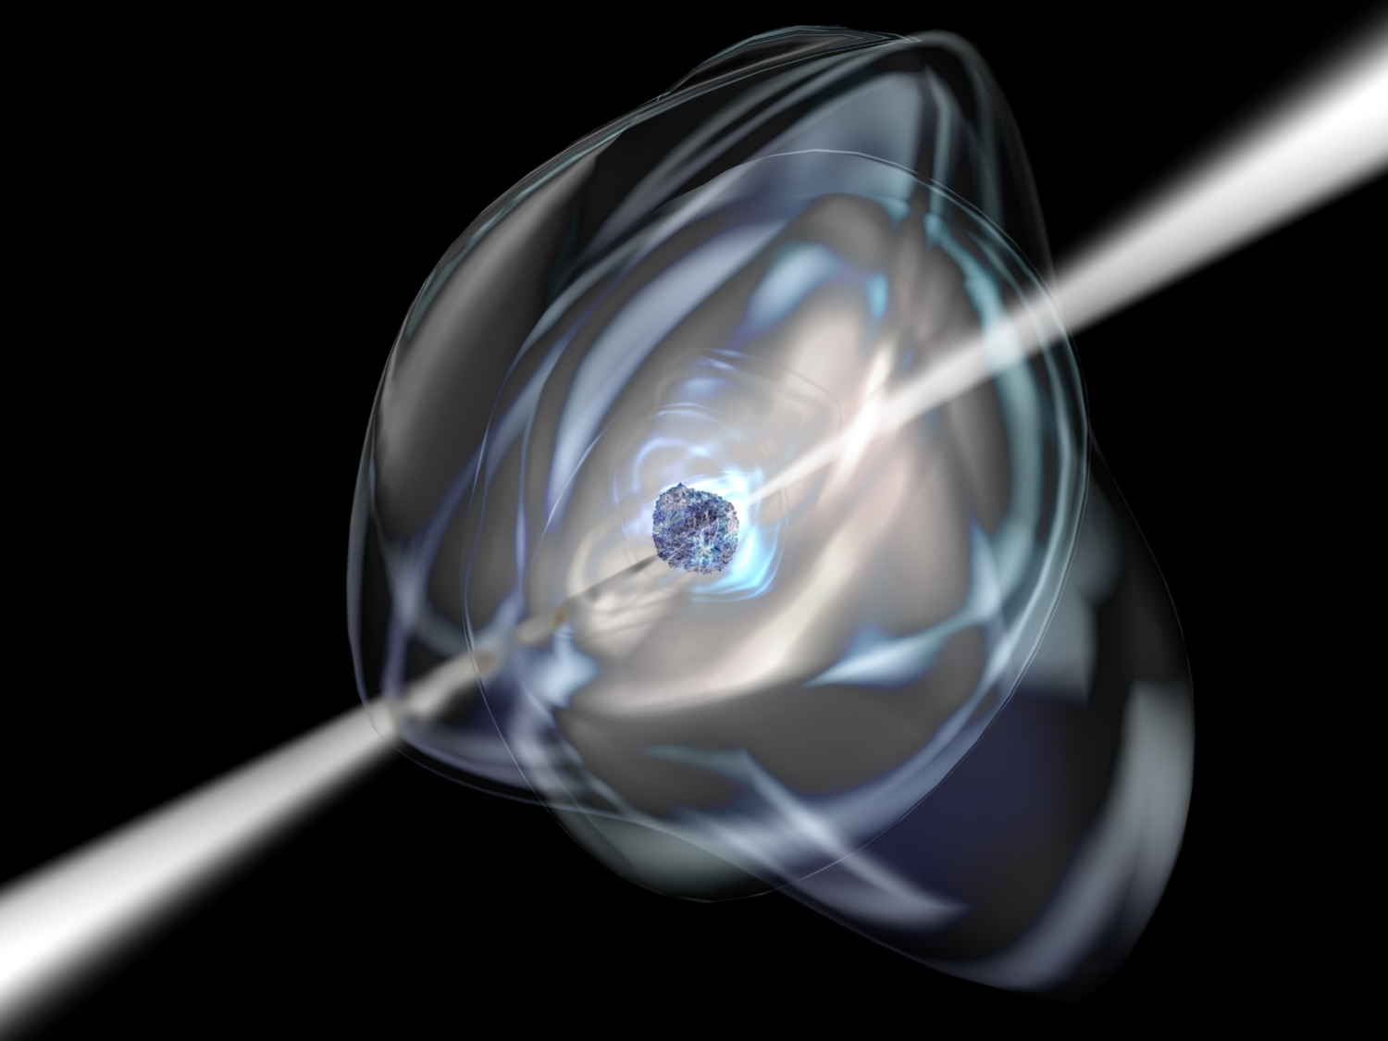
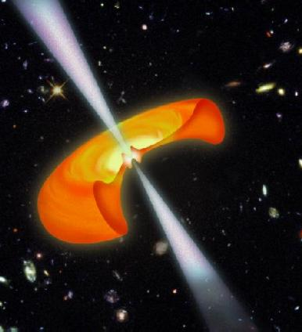
Can the jet breakout time reveal the nature of the central engine that powers Collapsar GRBs?
“Magnetar” driven jet
Accretion driven jet

Slide 32
Hydrodynamic Jet Propagation
Head
Forward &
reverse
Shocks
r_{jet}
Medium
Jet
Collimation
Shock
Cocoon
(O.B. & Levinson 2007)
O.B. et al 2011a

Slide 33
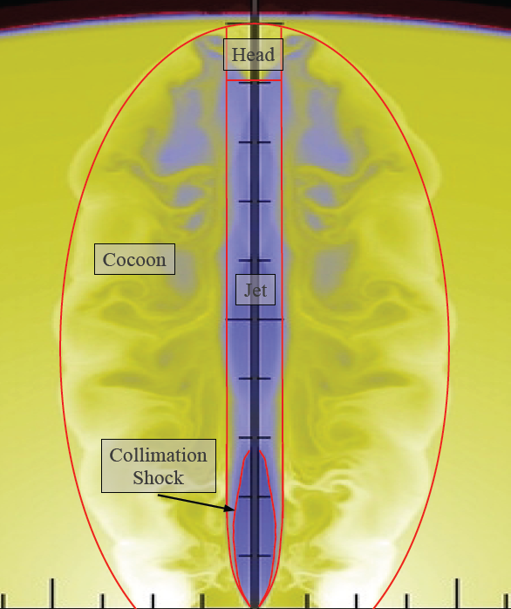
Hydrodynamic Jet Propagation
Head
Forward &
reverse
Shocks
r_{jet}
Medium
Jet
Collimation
Shock
Cocoon
(O.B. & Levinson 2007)
O.B. et al 2011a

Slide 34
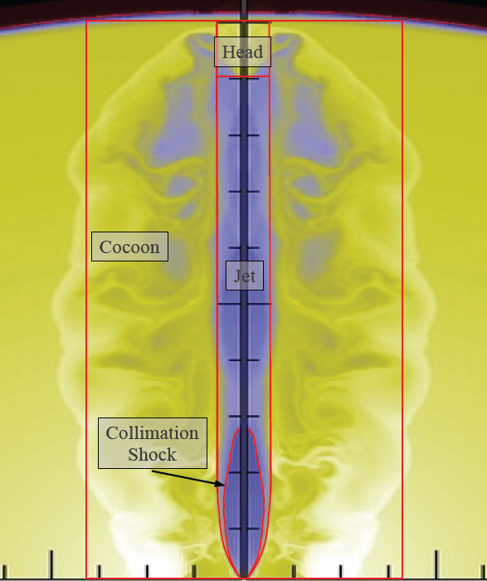
Hydrodynamic Jet Propagation
Unknowns:
Cocoon pressure
Cocoon size
Head velocity
Jet cross-section
Jet Lorentz factor
Initial conditions:
luminosity – L_{j}
Injection angle – θ₀
Medium Density- ρ(z)
O.B. et al 2011
Morsony et al., 07

Slide 35
Log₁₀(ρ)
Z/10⁹cm
Mizuta & Aloy 09
R/10⁹cm

Slide 36
Comparison with simulations
t_{b} α L^{-1/3}
Us:
L
T
25
12
6
51
Zhang et al., 04

Slide 37
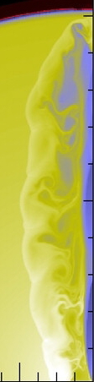
The concept of Jet Breakout
The head is slower than the jet material, and dissipates the jet energy.
To propagate the head needs to be continually pushed by the jet material.
If the engine stops before the jet will fail!

Slide 38
The concept of Jet Breakout
The head is slower than the jet material, and dissipates the jet energy.
To propagate the head needs to be continually pushed by the jet material.
If the engine stops before the jet will fail!
Minimal engine work time that leads to jet breakout:
Failed jet
(O.B. et al 2011)
_{ʘ}
_{ʘ}

Slide 39
Hydrodynamic Jet Propagation
Head
Forward &
reverse
Shocks
r_{jet}
Medium
Jet
Collimation
Shock
Cocoon
(O.B. & Levinson 2007)

Slide 40
Magnetic Jet Propagation
`
Head
Head
r_{L}
r_{jet}
Jet
Jet
No Shocks
(O.B+ 2013 in prep)
Cocoon
Cocoon
Cocoon
Cocoon

Slide 41
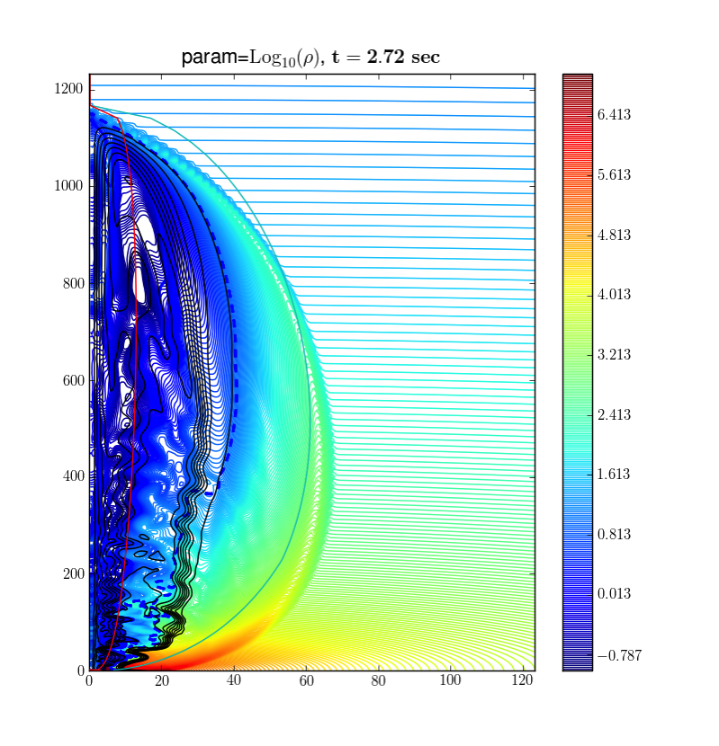
Comparison with Simulations
The jet becomes relativistic deep in the star.
It crosses the star at a time comparable to R/c
The minimal activity time in this case:
_{ʘ}

Slide 42
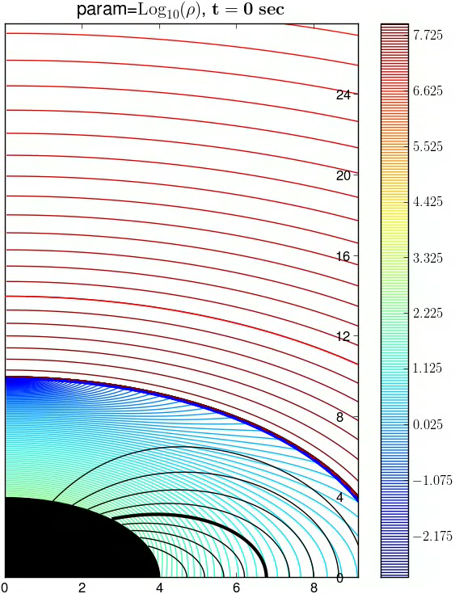
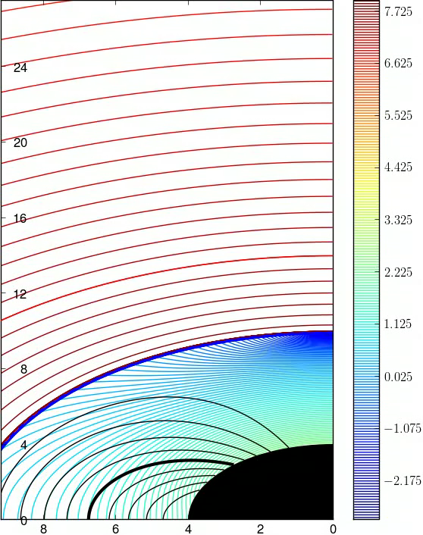
Breakout times:
O.B. et al 2011a
O.B. et al 2013 in prep
_{ʘ}
_{ʘ}
_{ʘ}
Breakout times infered from observations ~ 10-15 sec.
Favors hydrodynamic jets over magnetic jets in typical collapsars
O.B. & Tchekhovskoy 2013 in prep

Slide 43
Conclusions I
Jet breakout implies a flat distribution up to t_{b}
If t_{e}<t_{b} we get a “failed jet” observed as a low luminosity GRB
The rate of ll-GRBs is much higher than GRBs
The plateau in the distribution can be used as a reliable method to classify short duration Collapsars and non-Collapsars.
Thershold durations (without hardness):
  BATSE : T_{th}= 3 sec.
  Fermi : T_{th}= 2 sec.
  Swift: T_{th}= 0.8 sec.

Slide 44
Conclusions II
Typical breakout times inferred from observations t_{b} = 10-15 s
These times favor hydrodynamic jets over magnetic jets.
If accretion driven jets can have low magnetization accreting compact objects are favorable over isolated magnetars as collapsars engines.

